Slide 1



NOIDA INSTITUTE OF ENGINEERING AND TECHNOLOGY, GREATER NOIDA
Introduction to Computer Vision
Unit: 1
Subject Name:
Computer Vision
Faculty Name:
Ms.Shivani Sharma
Affiliation:
Assistant Professor
Department:
CSE
Course Details:
B.Tech 7th Sem

Slide 2

UNIT-I
UNIT-I: Introduction to Computer Vision:
Introduction to Computer Vision
Computer Vision, Research and Applications, (Self-Driving Cars, Facial Recognition, Augmented & Mixed Reality, Healthcare). Most popular examples Categorization of Images, Object Detection, Observation of Moving Objects, Retrieval of Images Based on Their Contents, Computer Vision Tasks classification, object detection, Instance segmentation. Convolutional Neural Networks, Evolution of CNN Architectures for Image, Recent CNN

Slide 3
UNIT-II
UNIT-I: Architectures
Architectures
Representation of a Three-Dimensional Moving Scene. Convolutional layers, pooling layers, and padding. Transfer learning and pre-trained models Architectures.
Architectures Design: LeNet-5, AlexNet, VGGNet, GoogLeNet, ResNet, Efficient Net, Mobile Net, RNN Introduction.

Slide 4
UNIT-III
UNIT-III: Segmentation
Segmentation
Popular Image Segmentation Architectures, FCN Architecture, Upsampling Methods, Pixel Transformations, Geometric Operations, Spatial Operations in Image Processing, Instance Segmentation, Localisation, Object detection and image segmentation using CNNs, LSTM and GRU’s. Vision Models, Vision Languages, Quality Analysis, Visual Dialogue, Active Contours & Application, Split & Merge, Mean Shift & Mode Finding, Normalized Cuts.

Slide 5
UNIT-IV
UNIT-I: Architectures
Object Detection
Object Detection and Sliding Windows, R-CNN, Fast R-CNN, Object Recognition, 3-D vision and Geometry, Digital Watermarking. Object Detection, face recognition instance Recognition, Category Recognition Objects, Scenes, Activities, Object classification.

Slide 6
UNIT-V
UNIT-V: Visualization and Generative Models
Visualization and Generative Models
Object Detection and Sliding Windows, R-CNN, Fast R-CNN, Object Recognition, 3-D vision and Geometry, Digital Watermarking. Object Detection, face recognition instance Recognition, Category Recognition Objects, Scenes, Activities, Object classification.

Slide 7
Syllabus
Unit | Module | Topics Covered
1 | Introduction to Computer Vision: | Computer Vision, Research and Applications, (Self-Driving Cars, Facial Recognition, Augmented & Mixed Reality, Healthcare). Most popular examples Categorization of Images, Object Detection, Observation of Moving Objects, Retrieval of Images Based on Their Contents, Computer Vision Tasks classification, ,object detection, Instance segmentation. Convolutional Neural Networks, Evolution of CNN Architectures for Image, Recent CNN
2 | Architectures | Representation of a Three-Dimensional Moving Scene. Convolutional layers, pooling layers, and padding. Transfer learning and pre-trained models Architectures. Architectures Design : LeNet-5, AlexNet, VGGNet, GoogLeNet, ResNet, Efficient Net, Mobile Net . RNN Introduction, perceptron Backpropagation in CNN,RNN.
3 | Segmentation | Popular Image Segmentation Architectures, FCN Architecture, Upsampling Methods, Pixel Transformations, Geometric Operations, Spatial Operations in Image Processing, Instance Segmentation, Localisation, Object detection and image segmentation using CNNs, LSTM and GRU’s. Vision Models, Vision Languages, Quality Analysis, Visual Dialogue, other attention models, self attention and transformers. Active Contours & Application, Split & Merge, Mean Shift & Mode Finding, Normalized Cuts,
4 | Object Detection | Object Detection and Sliding Windows, R-CNN, Fast R-CNN, Object Recognition, 3-D vision and Geometry, Digital Watermarking. Object Detection, face recognition instance Recognition, Category Recognition Objects, Scenes, Activities, Object classification and detection, Encoder in Code, Decoder in Code, U-Net Code: Encoder, Decoder , Few Shot and zero shot learning, self-supervised learning, Adversarial Robustness, Pruning and model compression, Neural Architecture search, Objects in Scenes. YOLO Fundamentals of Image Formation, Convolution and Filtering.
5 | Visualization and Generative Models | Benefits of Interpretability, Fashion MNIST Class Activation Map code walkthrough, GradCAM,ZFNet.Image compression methods and its requirements,statisticalcompression, spatial compression, contour coding. Deep Generative Models introduction,Generative Adversarial Networks Combination VAE and GAN’s, other VAE and GAN’s deep generative models. GAN Improvements, Deep Generative Models across multiple domains, Deep Generative Models image and video applications.

Slide 8
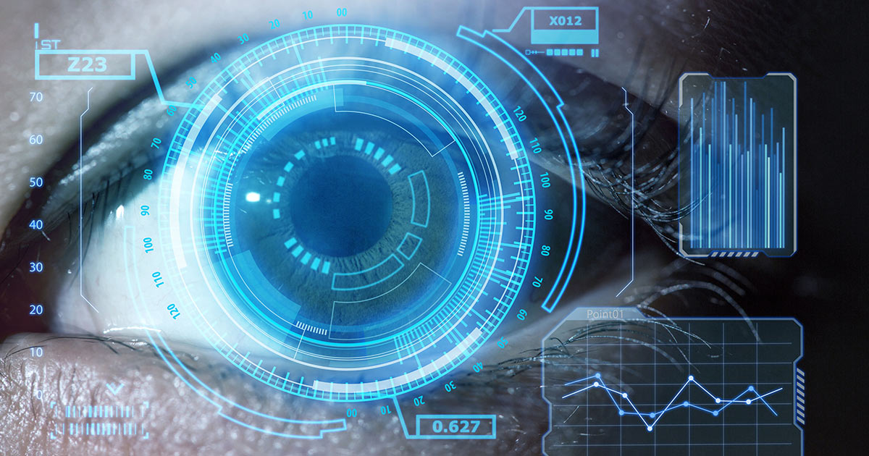
Course Objective
Course Objective: To learn about key features of Computer Vision, design, implement and provide continuous improvement in the accuracy and outcomes of various datasets with more reliable and concise analysis results.

Slide 9
Course Outcome
Course outcome: After completion of this course students will be able to
 | Description | Bloom’s Taxonomy
CO1 | Analyse knowledge of deep architectures used for solving various Vision and Pattern Association tasks. | K4
CO2 | Develop appropriate learning rules for each of the architectures of perceptron and learn about different factors of back propagation. | K2
CO3 | Deploy training algorithm for pattern association with the help of memory network. | K5
CO4 | Design and deploy the models of deep learning with the help of use cases. | K5
CO5 | Understand, Analyse different theories of deep learning using neural networks. | K3

Slide 10
Program Outcome
At the end of the semester, the student will be able:
POs | Engineering Graduates will be able to
PO1 | Engineering Knowledge
PO2 | Problem Analysis
PO3 | Design & Development of solutions
PO4 | Conduct Investigation of complex problems
PO5 | Modern Tool Usage
PO6 | The Engineer and Society
PO7 | Environment and sustainability
PO8 | Ethics
PO9 | Individual & Team work
PO10 | Communication
PO11 | Project management and Finance
PO12 | Life Long Learning

Slide 11
CO-PO and PSO Mapping
Computer vision
CO.K | PO1 | PO2 | PO3 | PO4 | PO5 | PO6 | PO7 | PO8 | PO9 | PO10 | PO11 | PO12
Subject code | 3 |  | 2 |  | 1
Subject code | 2 |  | 1
Subject code |  | 2 |  |  |  | 3
Subject code | 3 | 3 |  | 2
Subject code | 3 |  | 2 |  | 1 |  | 1
avg

Slide 12
Program Educational Objectives(PEOs)
PEO1: To have an excellent scientific and engineering breadth so as to
comprehend, analyze, design and provide sustainable solutions for
real-life problems using state-of-the-art technologies.
PEO2:To have a successful career in industries, to pursue higher studies or
to support enterpreneurial endeavors and to face global challenges.
PEO3:To have an effective communication skills, professional attitude,
ethical values and a desire to learn specific knowledge in emerging
trends, technologies for research, innovation and product
development and contribution to society.
PEO4: To have life-long learning for up-skilling and re-skilling for
successful professional career as engineer, scientist, enterpreneur
and bureaucrat for betterment of society

Slide 13
End Semester Question Paper Template
B TECH
(SEM-VII) THEORY EXAMINATION 20__-20__
DESIGN AND ANALYSIS OF ALGORITHMS
Time: 3 Hours Total Marks: 100
Note: 1. Attempt all Sections. If require any missing data; then choose suitably.
SECTION A
Attempt all questions in brief. 2 x 10 = 20
Q.No. | Question | Marks | CO
1 |  | 2
2 |  | 2
. |  | .
10 |  | 2

Slide 14
End Semester Question Paper Templates
SECTION B
2. Attempt any three of the following: 3 x 10 = 30
SECTION C
3. Attempt any one part of the following: 1 x 10 = 10
Q.No. | Question | Marks | CO
1 |  | 10
2 |  | 10
. |  | .
5 |  | 10
Q.No. | Question | Marks | CO
1 |  | 10
2 |  | 10

Slide 15
End Semester Question Paper Templates
4. Attempt any one part of the following: 1 x 10 = 10
5. Attempt any one part of the following: 1 x 10 = 10
6. Attempt any one part of the following: 1 x 10 = 10
Q.No. | Question | Marks | CO
1 |  | 10
2 |  | 10
Q.No. | Question | Marks | CO
1 |  | 10
2 |  | 10
Q.No. | Question | Marks | CO
1 |  | 10
2 |  | 10

Slide 16
Introduction About Subject With Videos
Computer vision is a field of artificial intelligence (AI) that enables computers and systems to derive meaningful information from digital images, videos and other visual inputs — and take actions or make recommendations based on that information.
Computer Vision covers a huge ground as its applications know no bounds. It often escapes our minds as we fail to notice the role Computer Vision plays in the gadgets, we use day in and day out.

Slide 17
Unit Content
CONTENT
Computer Vision
Research and Applications (Self-Driving Cars, Facial Recognition, Augmented & Mixed Reality, Healthcare).
Most popular examples Categorization of Images
Object Detection
Observation of Moving Objects
Retrieval of Images Based on Their Contents
Computer Vision Tasks classification
object detection
Instance segmentation
Convolutional Neural Networks
Evolution of CNN Architectures for Image
Recent CNN

Slide 18
CO-PO and PSO Mapping
 | PSO1 | PSO2 | PSO3
Subject code |  | 1 | 2
Subject code |  |  | 2
Subject code | 1
Subject code | 1 | 2 | 3
Subject code | 1 | 1 | 2
avg
*3= High *2= Medium *1=Low

Slide 19
PREREQUISITE
Students should have the knowledge of computer organization
Students should know the artificial intelligence basic concepts.
Students should be able to create, design and manipulate the images and idea about pixels

Slide 20
PREREQUISITE
Prerequisites
No prior experience with computer vision is assumed, although previous knowledge of visual computing or signal processing will be helpful (e.g., CSCI 1230). The following skills are necessary for this class:
Math: Linear algebra, vector calculus, and probability. Linear algebra is the most important and is required.
Data structures: You will write code that represents images as matrices, high-dimensional features, and geometric constructions.
Programming and toolchains: A good working knowledge. Intro CS is required, and an intermediate systems course is strongly encouraged.

Slide 21
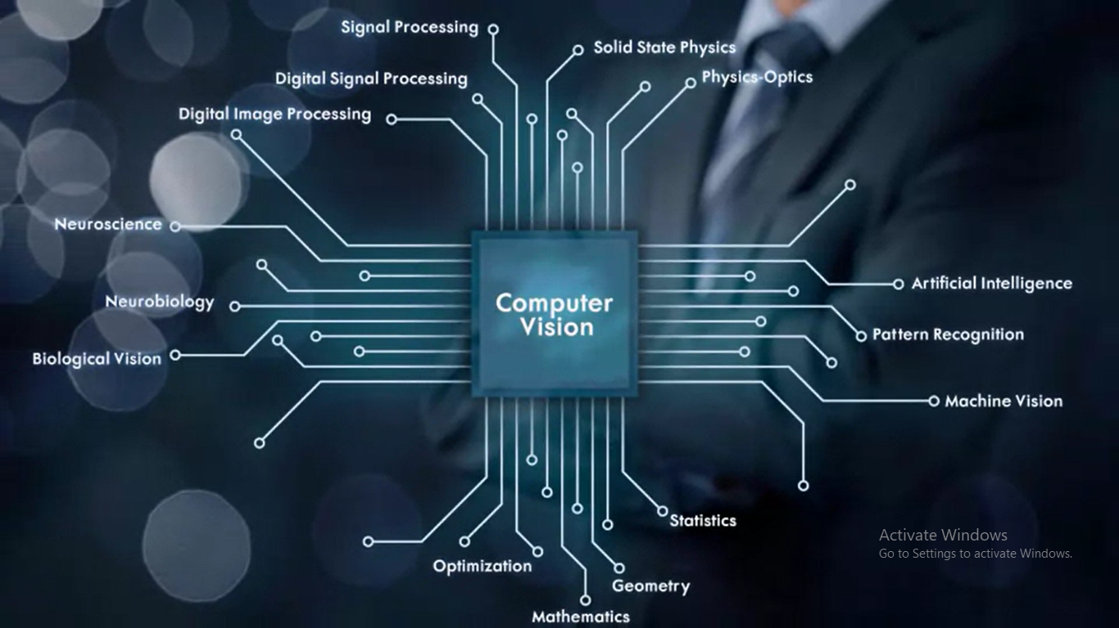
Computer Vision

Slide 22
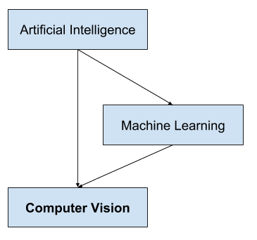
Computer Vision
a field of study that seeks to develop techniques to help computers “see” and understand the content of digital images such as photographs and videos.
It is a multidisciplinary field that could broadly be called a subfield of artificial intelligence and machine learning, which may involve the use of specialized methods and make use of general learning algorithms.

Slide 23

Computer Vision
Artificial intelligence (AI), also known as machine intelligence, is a branch of computer science that focuses on building and managing technology that can learn to autonomously make decisions and carry out actions on behalf of a human being.

Slide 24
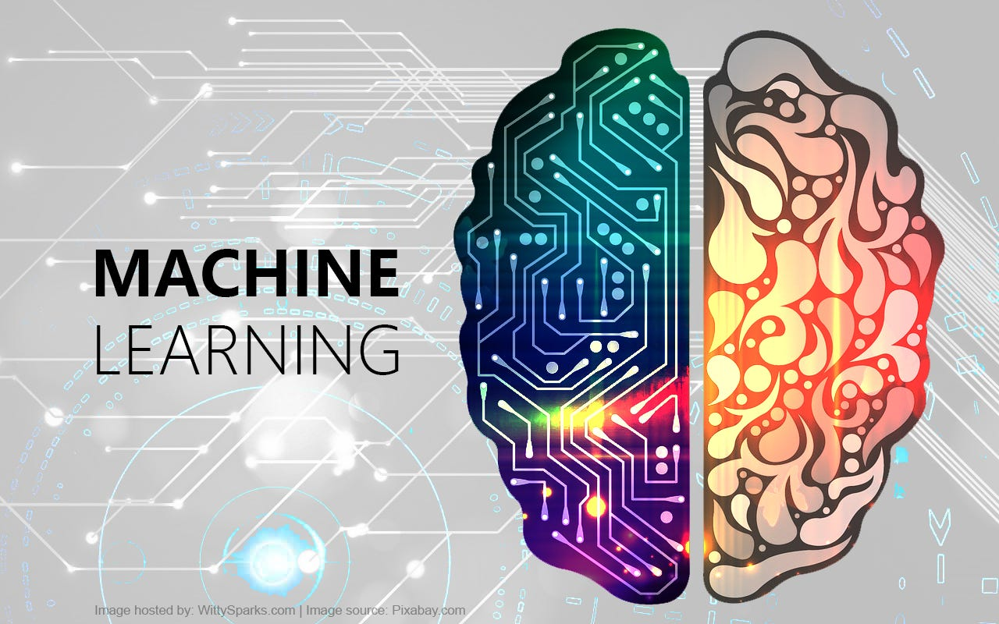
Computer Vision
What is machine learning?
Machine learning is a subfield of artificial intelligence, which is broadly defined as the capability of a machine to imitate intelligent human behavior. Artificial intelligence systems are used to perform complex tasks in a way that is similar to how humans solve problems.

Slide 25
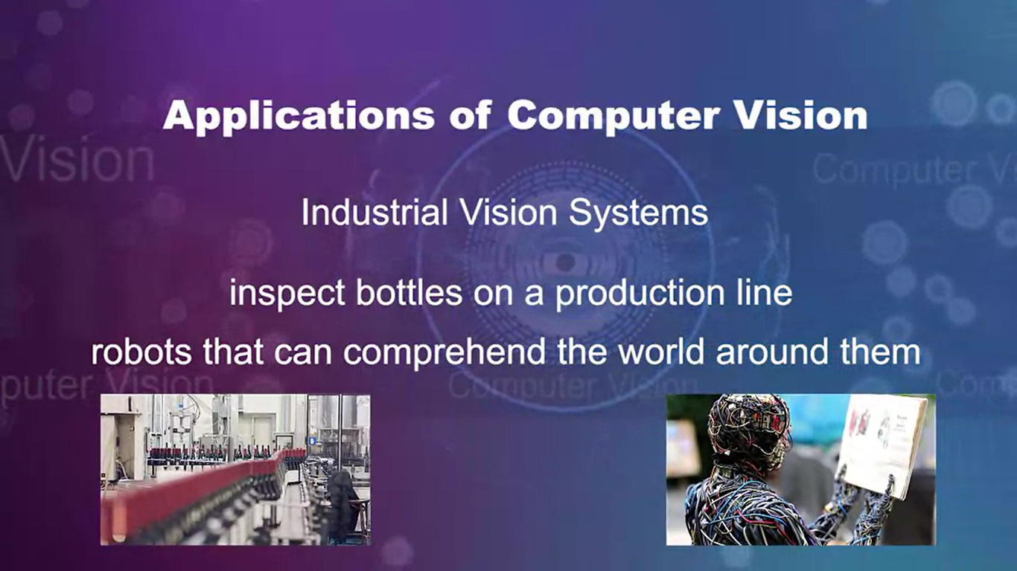
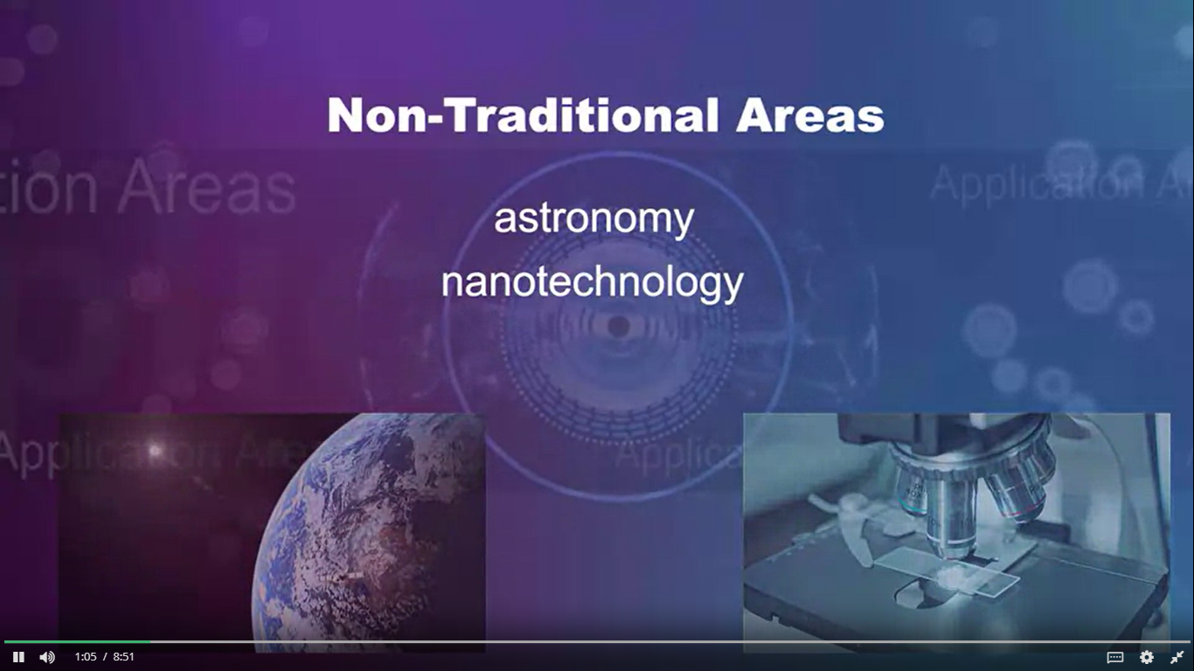
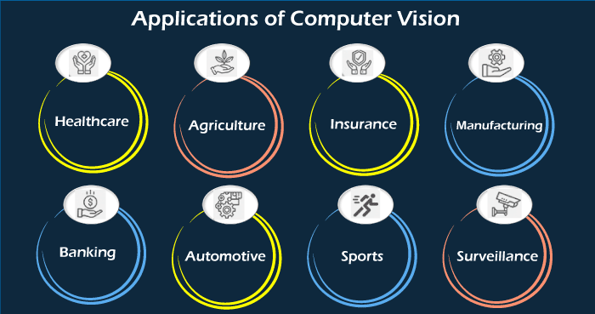
Computer Vision Applications

Slide 26
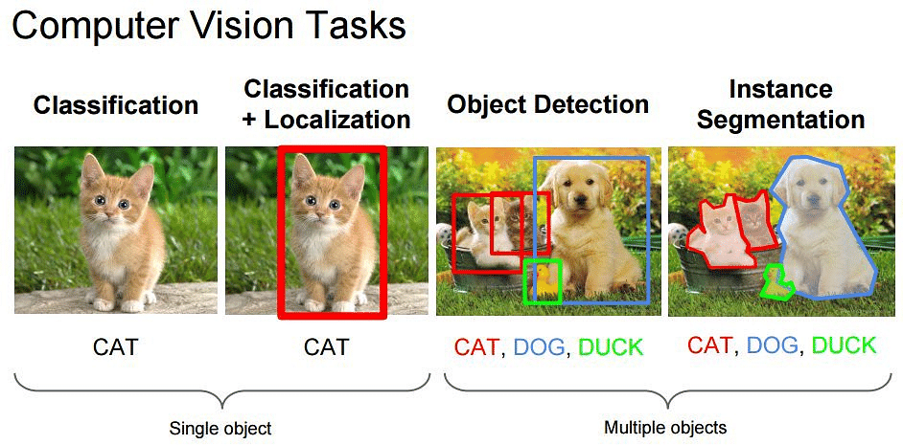
Computer Vision Applications
Computer Vision Applications
Self-Driving Cars
Facial Recognition
Augmented & Mixed Reality
Healthcare
Categorization of Images
Object Detection
Observation of Moving Objects
Retrieval of Images Based on Their Contents

Slide 27
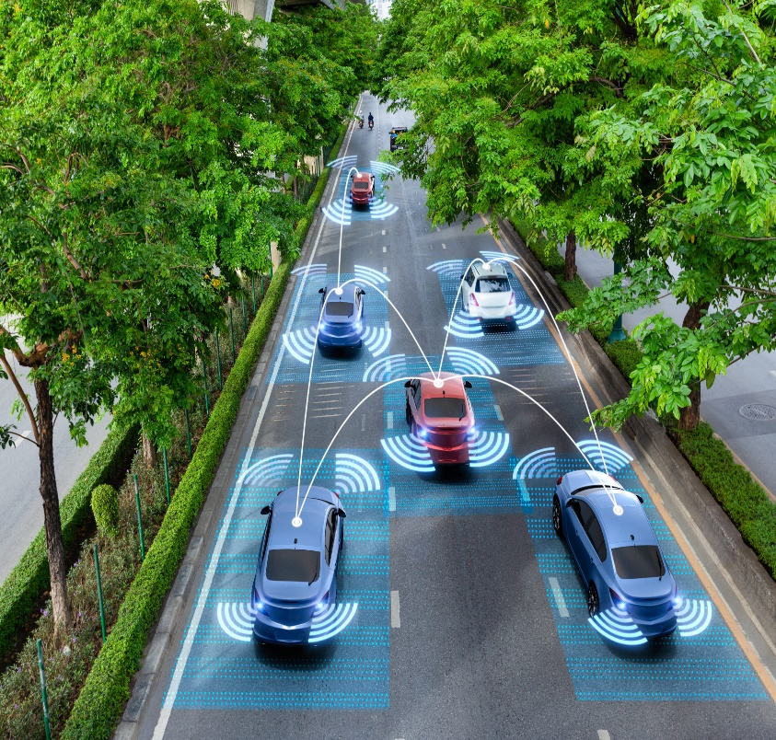
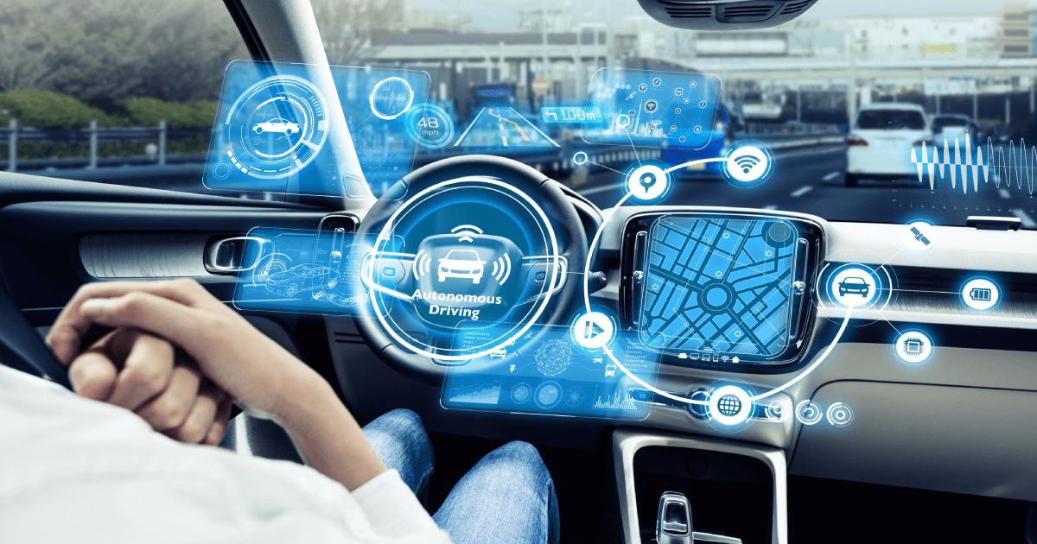
Self Driving cars
An autonomous car is a vehicle capable of sensing its environment and operating without human involvement. A human passenger is not required to take control of the vehicle at any time, nor is a human passenger required to be present in the vehicle at all. An autonomous car can go anywhere a traditional car goes and do everything that an experienced human driver does.

Slide 28
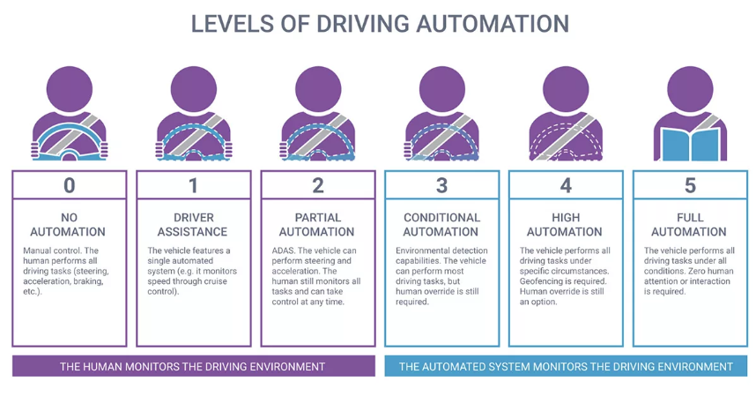
Self Driving cars
The Benefits Of Autonomous Cars
Reduce traffic congestion (30% fewer vehicles on the road)
Cut transportation costs by 40% (in terms of vehicles, fuel, and infrastructure)
Improve walkability and livability
Free up parking lots for other uses (schools, parks, community centers)
Reduce urban CO2 emissions by 80% worldwide

Slide 29
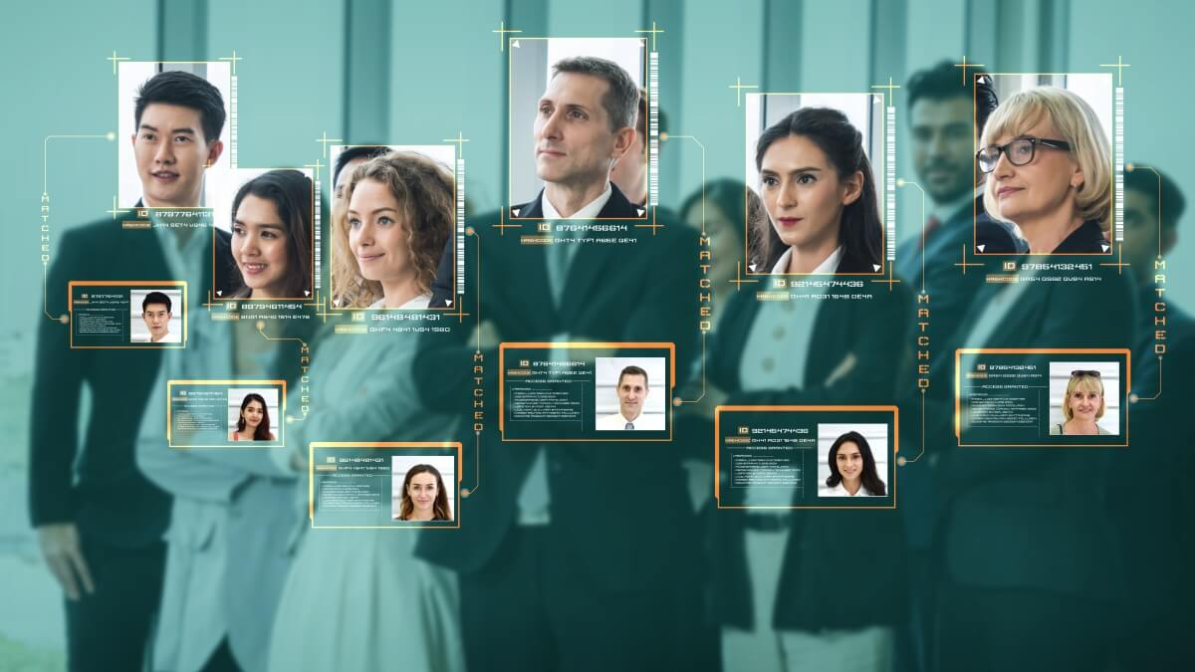
facial recognition
What is facial recognition?
Facial recognition is a way of identifying or confirming an individual’s identity using their face. Facial recognition systems can be used to identify people in photos, videos, or in real-time.
Procedure
Step 1: Face detection
Step 2: Face analysis
Step 3: Converting the image to data
Step 4: Finding a match
How facial recognition is used
Unlocking phones
Law enforcement
Airports and border control
Finding missing persons
Reducing retail crime
Improving retail experiences
Banking
Marketing and advertising
Healthcare
Tracking student or worker attendance
Recognizing drivers
Monitoring gambling addictions

Slide 30

Augmented & Mixed Reality
Augmented reality is an interactive experience that enhances the real world with computer-generated perceptual information.
Virtual Reality (VR) is a computer-generated environment with scenes and objects that appear to be real, making the user feel they are immersed in their surroundings. This environment is perceived through a device known as a Virtual Reality headset or helmet.
Mixed reality (MR) is an emergent technology that blends virtual reality (VR) and augmented reality (AR). Mixed reality headsets like the Microsoft HoloLens are opening up possibilities in the gaming world for mixed reality experiences. These head-mounted displays include cameras that constantly map the wearer’s environment. When you play games made for these devices, characters can walk around the physical world you’re in and even help themselves to a seat on your couch.

Slide 31
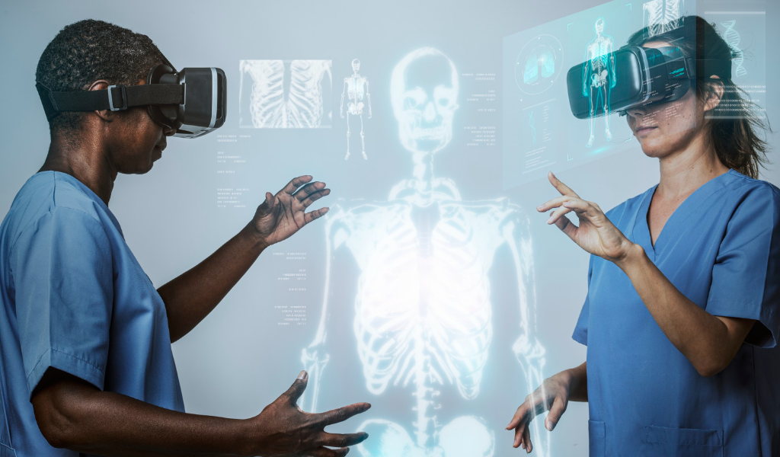
Healthcare
What is Computer Vision in Healthcare?
As surprising as it may sound, computer vision goes back as far as the 1960s, when computers started appearing at universities and scientific labs in large numbers. Back then, the growing infatuation with cybernetics and robotics paved the way for the emergence of several important disciplines, including artificial intelligence and computer vision.

Slide 32
Healthcare
Healthcare was one of the first industries to recognize the immense potential of computer vision and the convolutional neural networks (CNNs) powering the technology. Application of computer vision in the medical field is based on leveraging the capabilities of artificial intelligence and deep learning in a variety of contexts. Let’s name just a few of them:
DICOM image analysis
Detection of anomalies in MRI, CAT and X-ray scans
Diagnostic assistance
Surgical assistance and prevention of inadvertent retention of surgical instruments
Calculation of blood cells
Retina scans and early detection of structural changes
Identification and analysis of new or recurring skin anomalies
Remote monitoring and patient care

Slide 33
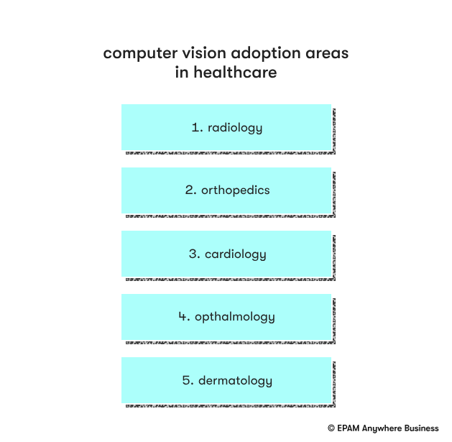
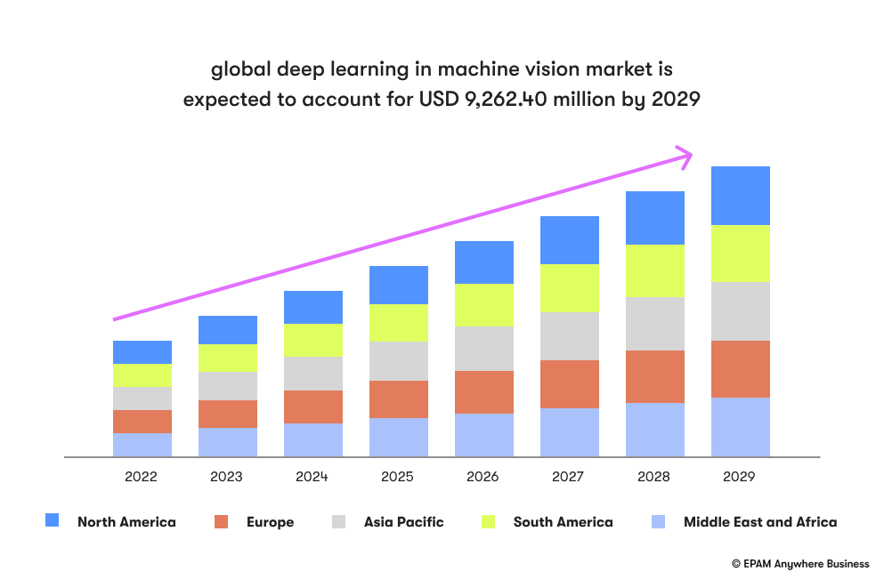
Healthcare

Slide 34
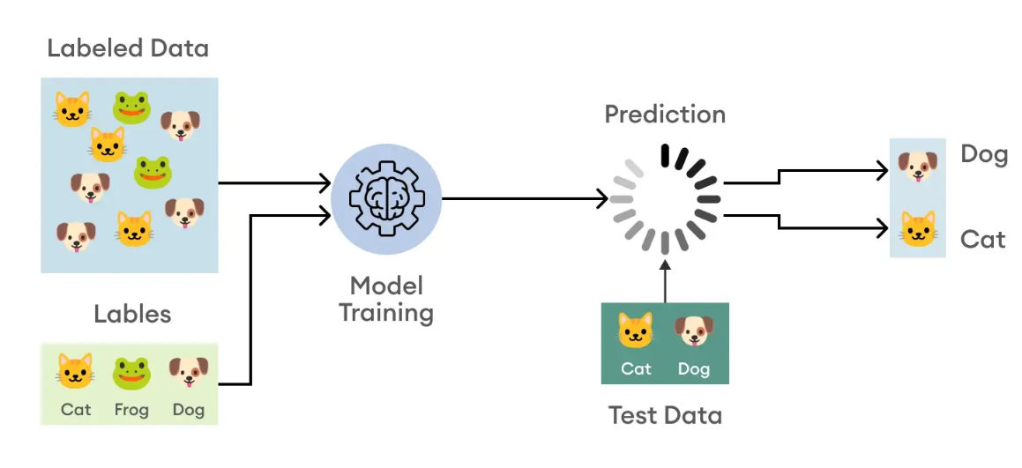
Most popular example Categorization of IMAGES
What is image classification?
Among computer vision tasks, image classification stands out with its irreplaceable role in modern technology. It involves assigning a label or tag to an entire image based on preexisting training data of already labeled images. While the process may appear simple at first glance, it actually entails pixel-level image analysis to determine the most appropriate label for the overall image. This provides us with valuable data and insights, enabling informed decisions and actionable outcomes.

Slide 35
Most popular example Categorization of IMAGES
Structure for performing Image Classification
Image Pre-processing: The aim of this process is to improve the image data (features) by suppressing unwanted distortions and enhancement of some important image features so that the computer vision models can benefit from this improved data to work on. Steps for image pre-processing includes Reading image, Resizing image, and Data Augmentation (Gray scaling of image, Reflection, Gaussian Blurring, Histogram, Equalization, Rotation, and Translation).
Detection of an object: Detection refers to the localization of an object which means the segmentation of the image and identifying the position of the object of interest.
Feature extraction and training: This is a crucial step wherein statistical or deep learning methods are used to identify the most interesting patterns of the image, features that might be unique to a particular class and that will, later on, help the model to differentiate between different classes. This process where the model learns the features from the dataset is called model training.
Classification of the object: This step categorizes detected objects into predefined classes by using a suitable classification technique that compares the image patterns with the target patterns.

Slide 36
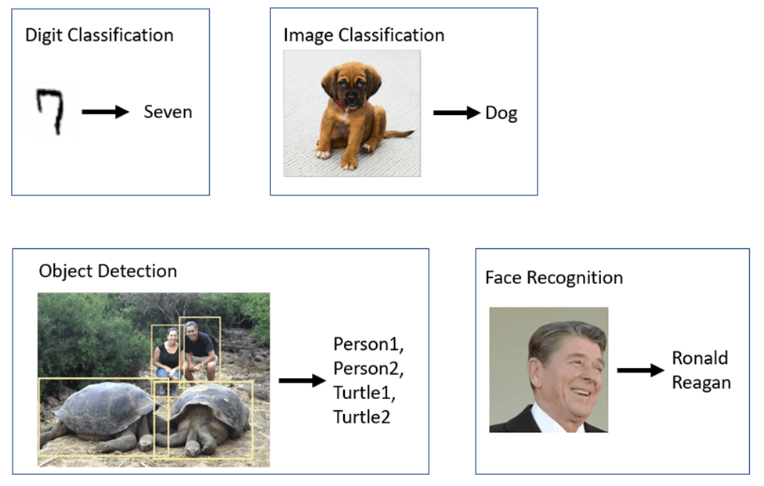
Most popular example Categorization of IMAGES

Slide 37
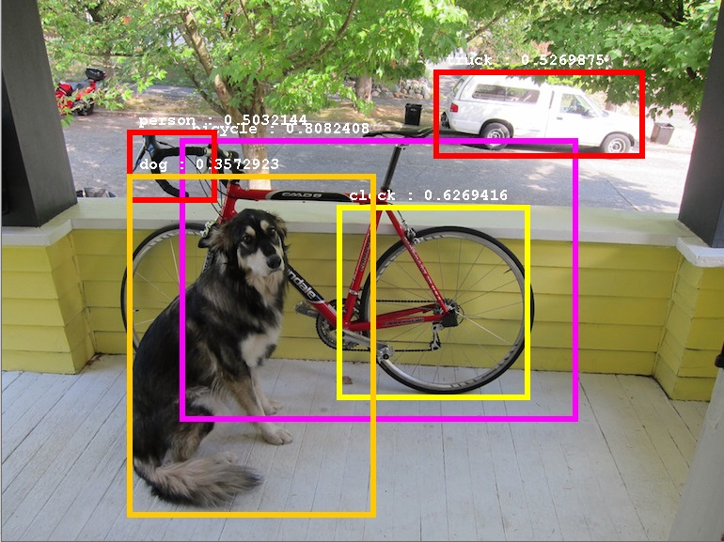
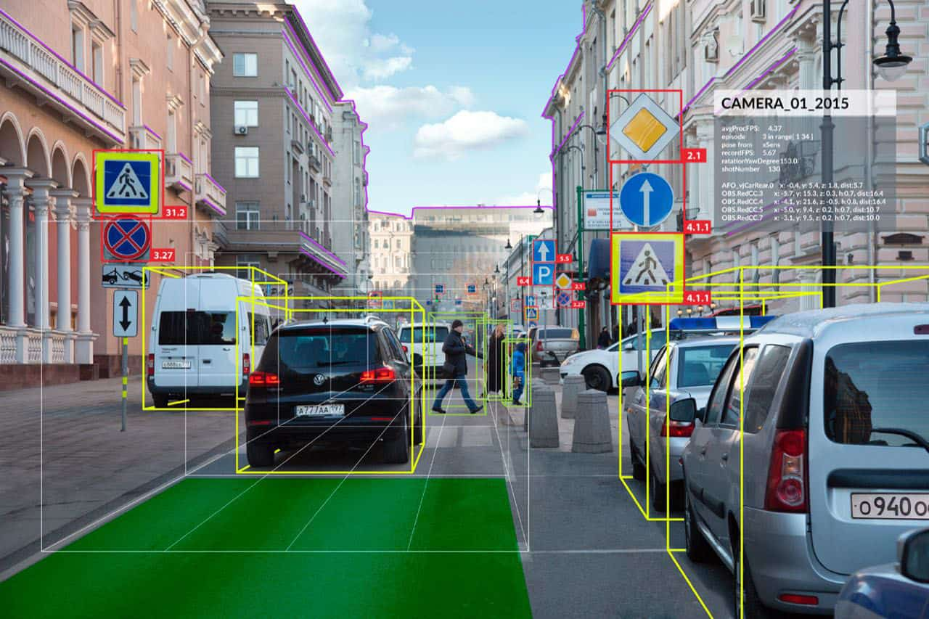
Object Detection

Slide 38
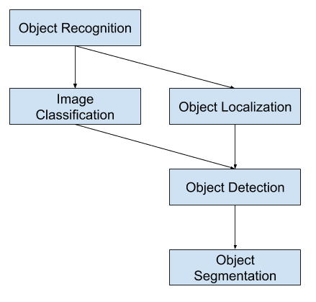
Object Detection
What is Object Recognition?
Object recognition is a general term to describe a collection of related computer vision tasks that involve identifying objects in digital photographs.
Image classification involves predicting the class of one object in an image. Object localization refers to identifying the location of one or more objects in an image and drawing abounding box around their extent. Object detection combines these two tasks and localizes and classifies one or more objects in an image.
When a user or practitioner refers to “object recognition“, they often mean “object detection“.
https://machinelearningmastery.com/object-recognition-with-deep-learning/

Slide 39
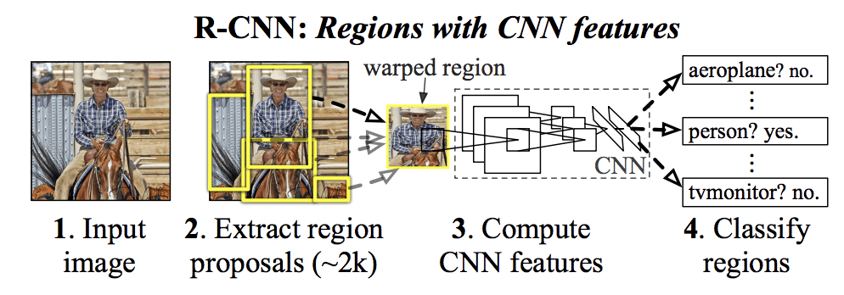
Object Detection
distinguish between these three computer vision tasks:
Image Classification: Predict the type or class of an object in an image.
Input: An image with a single object, such as a photograph.
Output: A class label (e.g. one or more integers that are mapped to class labels).
Object Localization: Locate the presence of objects in an image and indicate their location with a bounding box.
Input: An image with one or more objects, such as a photograph.
Output: One or more bounding boxes (e.g. defined by a point, width, and height).
Object Detection: Locate the presence of objects with a bounding box and types or classes of the located objects in an image.
Input: An image with one or more objects, such as a photograph.
Output: One or more bounding boxes (e.g. defined by a point, width, and height), and a class label for each bounding box.

Slide 40
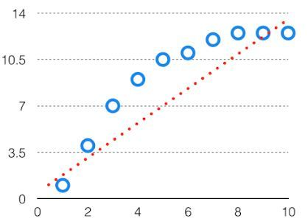
Bias-Variance Trade Off
Bias-Variance Trade Off
There is a tradeoff between a model’s ability to minimize bias and variance which is referred to as the best solution for selecting a value of Regularization constant. A proper understanding of these errors would help to avoid the overfitting and underfitting of a data set while training the algorithm.
Bias
The bias is known as the difference between the prediction of the values by the Machine Learning model and the correct value. Being high in biasing gives a large error in training as well as testing data. It recommended that an algorithm should always be low-biased to avoid the problem of underfitting. By high bias, the data predicted is in a straight line format, thus not fitting accurately in the data in the data set. Such fitting is known as the Underfitting of Data.

Slide 41
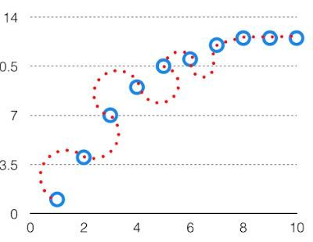
Bias-Variance Trade Off
Variance
The variability of model prediction for a given data point which tells us the spread of our data is called the variance of the model. The model with high variance has a very complex fit to the training data and thus is not able to fit accurately on the data which it hasn’t seen before. As a result, such models perform very well on training data but have high error rates on test data. When a model is high on variance, it is then said to as Overfitting of Data.

Slide 42
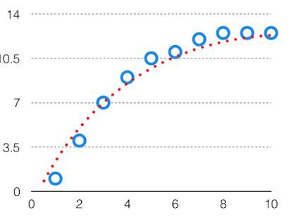
Bias-Variance Trade Off
Bias Variance Tradeoff
If the algorithm is too simple (hypothesis with linear equation) then it may be on high bias and low variance condition and thus is error-prone. If algorithms fit too complex (hypothesis with high degree equation) then it may be on high variance and low bias. In the latter condition, the new entries will not perform well. Well, there is something between both of these conditions, known as a Trade-off or Bias Variance Trade-off. This tradeoff in complexity is why there is a tradeoff between bias and variance

Slide 44
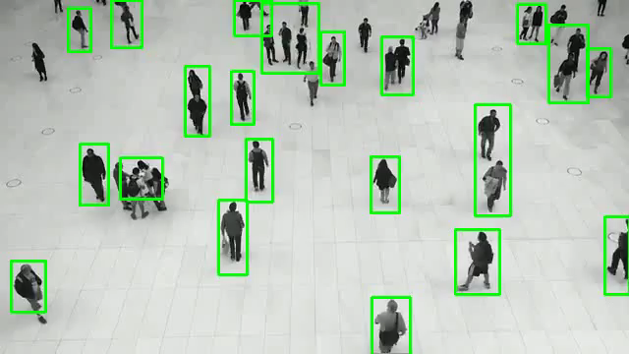
Observation of Moving Objects

Slide 45
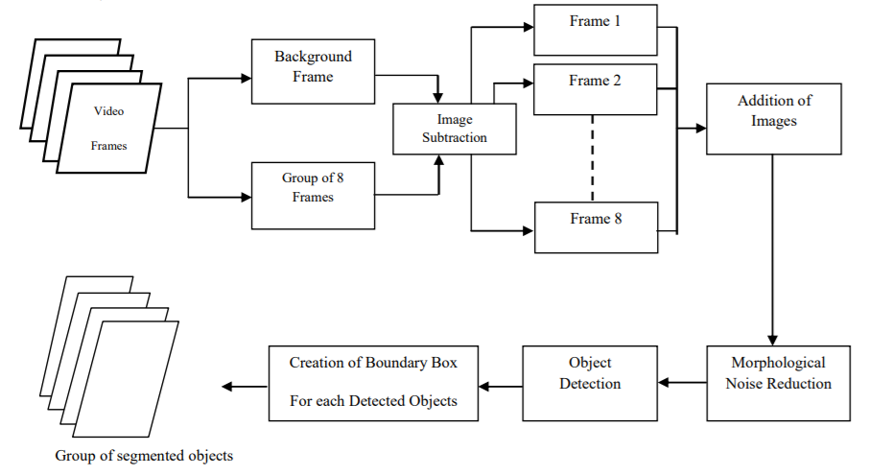
Observation of Moving Objects
Steps for Moving Object Detection using Frame Differencing and Summing
Detecting moving objects using frame differencing and summing involves some simple steps.
The authors have described it quite well in the paper. We will go through the steps briefly in this tutorial.
Let’s observe the block diagram which shows the complete procedure.
Figure 1. Figure illustrating the steps for moving object detection using frame differencing

Slide 46
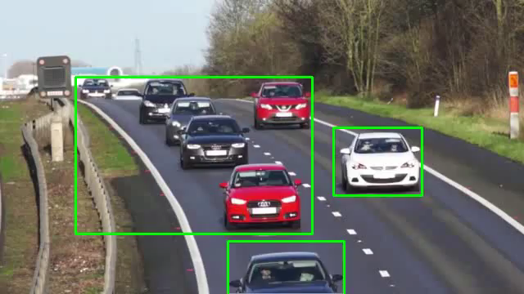
Observation of Moving Objects
https://debuggercafe.com/moving-object-detection-using-frame-differencing-with-opencv/

Slide 47
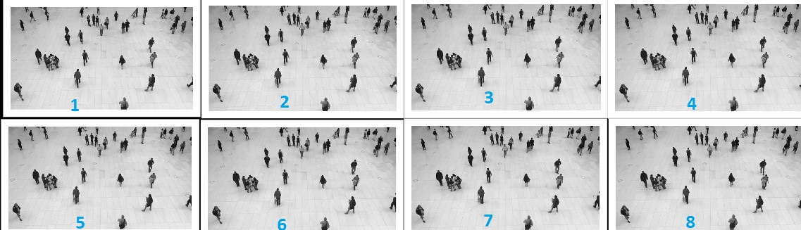
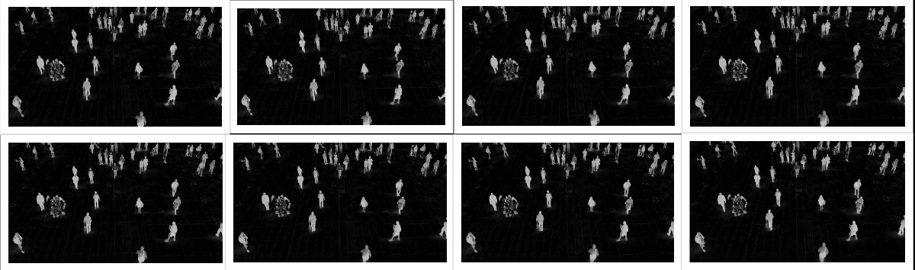
Observation of Moving Objects

Slide 48
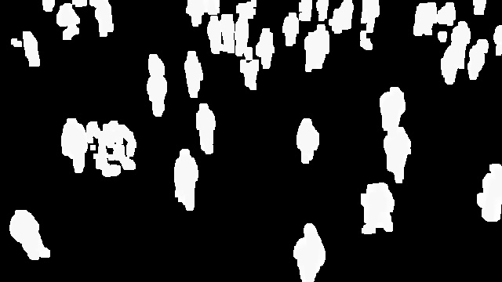
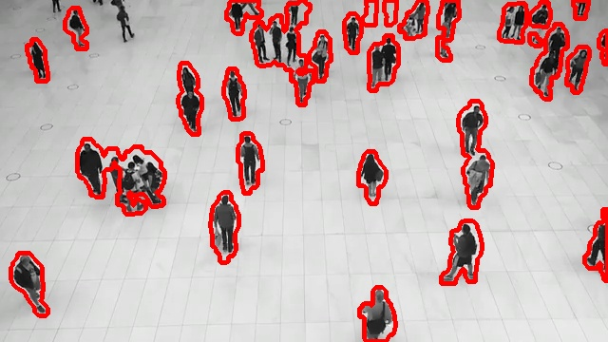
Observation of Moving Objects
Moving Object Detection and Segmentation
Step 1: Read 8 Consecutive Frames from the Video
Step 2: Convert the Frames into Grayscale
Step 3: Frame Differencing
Step 4: Add the 8 Frames
Step 5: Fill the Gaps Inside the Objects
Step 6: Convert to Binary
Step 7: Remove Noise from the Resulting Image

Slide 49
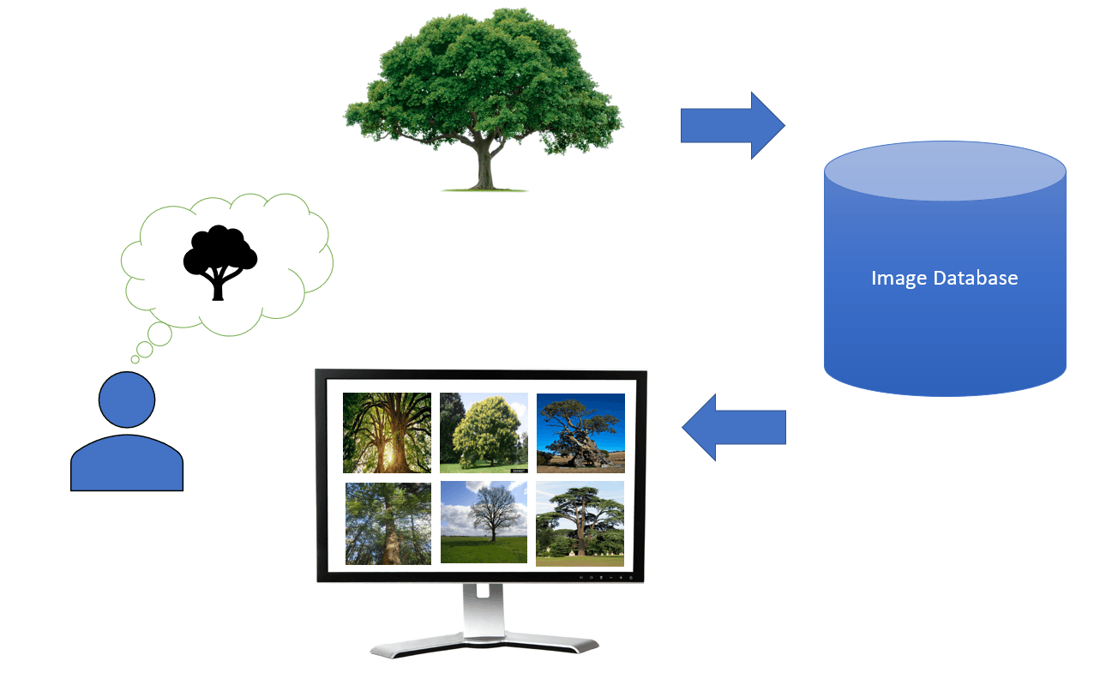
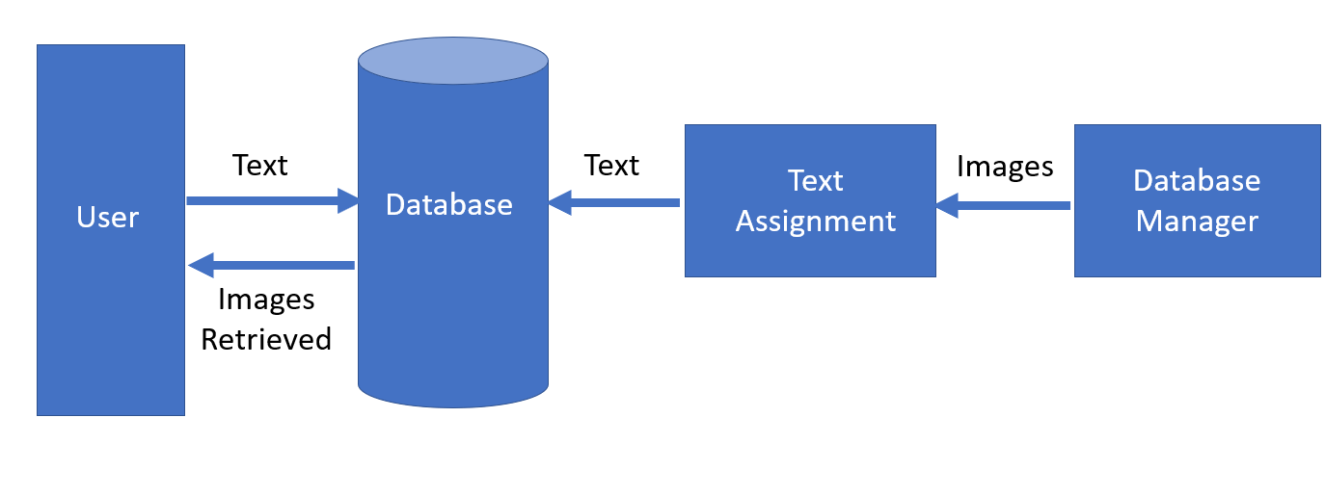
Retrieval of Images Based on Their Contents
The retrieval of images based on their content is known as content-based image retrieval (CBIR). CBIR aims to find images that are visually similar or relevant to a given query image, without relying on textual metadata or annotations. It relies on the visual features extracted from the images themselves to perform the search.

Slide 50
Retrieval of Images Based on Their Contents
Feature Extraction: The first step is to extract meaningful features from the images. Various low-level and high-level visual features can be used, such as color histograms, texture descriptors, shape descriptors, deep learning features (e.g., features from convolutional neural networks), or a combination of these. The choice of features depends on the specific requirements and characteristics of the image dataset.
Feature Representation: The extracted features are then typically transformed into a suitable representation for efficient indexing and retrieval. This can involve techniques like vector quantization, dimensionality reduction (e.g., using techniques like Principal Component Analysis or t-SNE), or feature aggregation.
Indexing: The transformed feature representations are organized in a way that enables fast search and retrieval. Indexing structures like inverted files, k-d trees, or hash-based methods are commonly used to efficiently index the feature data.
Similarity Measurement: When a query image is provided, its features are extracted and compared to the features in the indexed database. Various similarity or distance measures, such as Euclidean distance, cosine similarity, or the Jaccard index, can be used to quantify the similarity between the query features and the features of the indexed images.
Ranking and Retrieval: Based on the similarity measurements, the indexed images are ranked in descending order of relevance to the query. The most similar images are returned as the retrieval results.

Slide 51
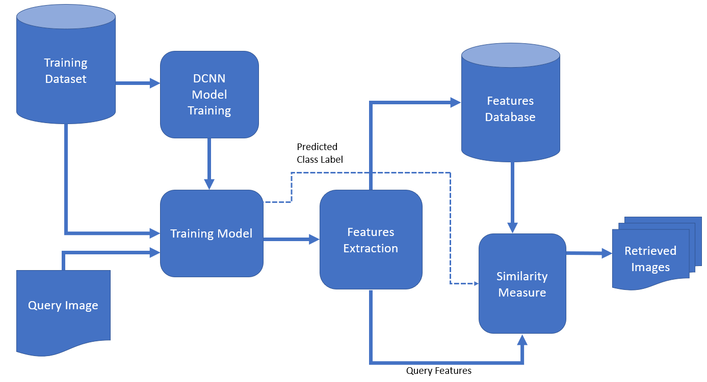
Retrieval of Images Based on Their Contents
Recently, state-of-the-art CBIR systems have started using machine-learning methods such as deep-learning algorithms. They can perform feature extraction far better than traditional methods.
Usually, a Deep Convolutional Neural Network (DCNN) is trained using available data. Its job is to extract features from images. So, when a user sends the query image to the database system, DCNN extracts its features. Then, the query-image features are compared to those of the database images. In that step, the database system finds the most similar images using similarity measures and returns them to the user:

Slide 52
Artificial Neural Network (ANN)
Noida Institute of Engineering and Technology, Greater Noida
An information processing paradigm inspired by human brain’s
information processing mechanism.
Composed of a large number of highly interconnected processing elements called neurons working in unison to solve specific problems.
– ANNs learn by examples like human being.
30

Slide 53
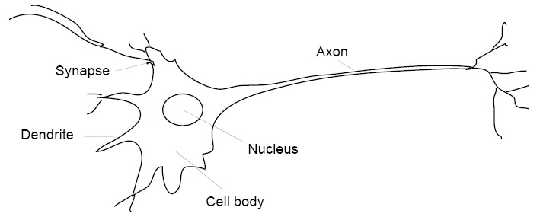
Neurons in the Brain
Noida Institute of Engineering and Technology, Greater Noida
The main purpose of neurons is to receive, analyze and transmit further the information in a form of signals (electric pulses).
When a neuron sends the information, we say that it “fires”.
Acting through specialized projections known as dendrites and axons, neurons carry information throughout the neural network.
31

Slide 54
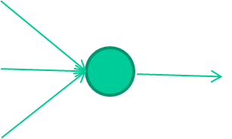
Mathematical Model: Neuron
Noida Institute of Engineering and Technology, Greater Noida
Input
weight
𝑥₁
Activation function
𝑤₁
𝑤₂
𝑥₂
෍
f(x)
output
𝑤₃
𝑥₃
Summing up the input
54

Slide 55
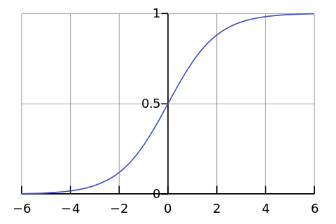
Mathematical Model: Neuron
Noida Institute of Engineering and Technology, Greater Noida
An Example
-0.06
Activation function
2.7
-2.5
1
-1.6
σ(x)
𝜎 𝑧 =
෍
1 + 𝑒^{−𝑧}
0.002
Weighted sum
z = -0.06×2.7 + 2.5×1.6 + 1.4×0.002 = 4.1648
𝜎 𝑧 = 0.9847
1.4
55

Slide 56
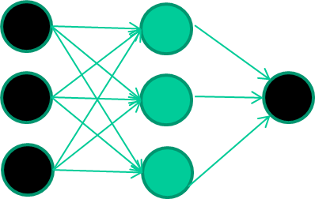
Mathematical Model: Neural Network
Noida Institute of Engineering and Technology, Greater Noida
A dataset
Features
class
1.4 | 2.7 | 1.9 | 0
3.8 | 3.4 | 3.2 | 0
6.4 | 2.8 | 1.7 | 1
4.1 | 0.1 | 0.2 | 0
etc …
56

Slide 57
Mathematical Model: Neural Network
Noida Institute of Engineering and Technology, Greater Noida
Train the NN
Initialise with random weights
Present a training pattern and feed it to the NN. Get an output and compare with actual value.
Training Data
Features
class
1.4
1.4 | 2.7 | 1.9 | 0
3.8 | 3.4 | 3.2 | 0 | 2.7
6.4 | 2.8 | 1.7 | 1
4.1 | 0.1 | 0.2 | 0 | 1.9
0.8
etc …
Expected output
Error = 0.8
57

Slide 58



Mathematical Model: Neural Network
Noida Institute of Engineering and Technology, Greater Noida
Train the NN
Initialise with random weights
Present a training pattern and feed
Present a training pattern and feed it to the NN. Get an output and compare with actual value.
Adjust and update the weights.
Training Data
Features class
1.4
1.4 | 2.7 | 1.9 | 0
3.8 | 3.4 | 3.2 | 0 | 2.7
6.4 | 2.8 | 1.7 | 1
4.1 | 0.1 | 0.2 | 0 | 1.9
0.8
etc …
Expected output
Error = 0.8
36

Slide 59
Mathematical Model: Neural Network
Noida Institute of Engineering and Technology, Greater Noida
Initialise with random weights
Present a training pattern and feed it to the NN.
Get an output and compare with actual value.
Adjust and update the weights.
Present a training pattern and feed it to the NN. Repeat the process to reduce the error.
Training Data
Features class
4.1
1.4 | 2.7 | 1.9 | 0
3.8 | 3.4 | 3.2 | 0 | 0.1
6.4 | 2.8 | 1.7 | 1
4.1 | 0.1 | 0.2 | 0 | 0.2
etc …
Next training pattern
59

Slide 60
Mathematical Model: Neural Network
Noida Institute of Engineering and Technology, Greater Noida
Weight adjustment process is repeated thousands and thousands of times.
Each time a random training example is taken, weights are slightly adjusted to tune the system for reducing error of approximation.
It may not be an efficient adjustment on many other cases.
But eventually the process of weight adjustments leads to a good enough model for producing an effective classifier.
It works well in many real applications.
60

Slide 61
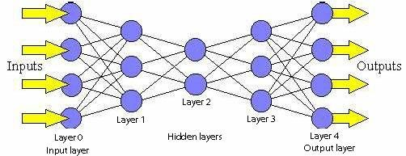
Feed Forward NNs
Noida Institute of Engineering and Technology, Greater Noida
Feed forward neural networks are the basic building blocks of NNs and deep learning.
The model is represented with a directed
Computes its own activation value
acyclic graph describing how the functions are composed together.
The function
𝑓 𝑥 = 𝑓⁴(𝑓³(𝑓²(𝑓¹(𝑥))))
tends to approximate 𝑓∗.
For each input x, the NN should approximate the corresponding y value.
NN is trained to minimize the error of approximation.
_{f}1
_{f}2
_{f}3
_{f}4
Width
61

Slide 62
Feed Forward NNs
Noida Institute of Engineering and Technology, Greater Noida
Each neuron of each layer receives a weighted sum of inputs from neurons of previous layers.
– Suppose you have 5 neurons (units) in 1st hidden layer and 4 units in the 2nd layer.
_{– 3}rd
unit of 2nd layer will receive weighted inputs from units of first layer as
follows.
𝒛_{𝟏}
_{𝑤}3
1
𝑤³𝑧 + 𝑤³𝑧 +∙∙∙ +𝑤³𝑧
1 1 2 2 5 5
𝒛_{𝟐}
_{𝑤}3
2
_{𝑤}3
𝒛_{𝟑}
3
_{𝑤}3
4
𝒛_{𝟒}
_{𝑤}3
5
𝒛_{𝟓}
62

Slide 63

General Form
Noida Institute of Engineering and Technology, Greater Noida
Binary Classification: To classify from a set of objects to class 0 or 1.
Problem Statement: Find out the probability of an object x belonging to one of the classes.
A set of training examples 𝑥¹
_{𝑥}2
…
_{𝑦}2
_{𝑥}𝑚
is given together
… 𝑦^{𝑚} , where
with the corresponding class labels 𝑦¹
each 𝑦 value is either 0 or 1.
We find out the probability 𝑦ො^{𝑖} for each 𝑦^{𝑖}.
Train the system to find out optimum values of parameters so as to reduce the training error (in other words minimize the loss or cost function).
Once this is done, the NN is ready to do classification.
63

Slide 64

General Form…
Noida Institute of Engineering and Technology, Greater Noida
Let us now formulate the Feed forward neural network in the general form.
Given the design matrix
_{𝑥}1 _{𝑥}2
…
_{𝑥}𝑚
_{𝑥1}1 _{𝑥1}2
_{𝑥2}1 _{𝑥2}2
⋮ ⋮
…
…
…
_{𝑥1}𝑚
_{𝑥2}𝑚
X=
⋮
_{𝑥𝑛}1 _{𝑥𝑛}2
…
_{𝑥𝑛}𝑚
To compute 𝑊^{𝑇}𝑋 + 𝑏 for the first layer.
Let the first weight matrix be denoted by 𝑊^{[1]} .
It is to randomly chosen and its dimension will be
– Number of features in each sample × Width of the first hidden layer.
The first bias vector 𝑏^{[1]} will be a single column vector of dimension = Width of the first hidden layer
64

Slide 65
General Form…
Noida Institute of Engineering and Technology, Greater Noida
Suppose there are 𝑙 hidden layers and each layer uses an identity activation function, that is 𝐼 𝑥 = 𝑥.
We can write the general expression as follows -
•
•
_{𝑧}[1] _{= 𝑊}[1]^{𝑇}_{𝑋 + 𝑏}[1]
= 𝑔 ¹ 𝑋 = 𝐼(𝑋) ;
_{𝑧}[2] _{= 𝑊}[2]^{𝑇}_{𝑧}[1] _{+ 𝑏}[2] _{𝑧} 1
= 𝑔 ² = 𝐼(𝑧 ¹ );
… … …
_{𝑧}[𝑙] _{= 𝑊}[𝑙]^{𝑇}_{𝑧}[𝑙−1] _{+ 𝑏}[𝑙] _{= 𝑔} 𝑙 _{𝑧} 𝑙−1 _{= 𝐼(𝑧} 𝑙−1 _{);}
Since the problem is about binary classification, we use the sigmoid function to find out the probability of a given sample in a class.
So 𝑔 ^{𝑙+1} (𝑧^{[𝑙]}) = 𝜎(𝑧^{[𝑙]}) =
1
.
1+exp(−𝑧^{[𝑙]})
65

Slide 66
Sigmoid Activation for Binary Classification
Noida Institute of Engineering and Technology, Greater Noida
Given 𝒙 ∈ 𝑹^{𝒏} with a label 𝑦 ∈ 𝑹
Find 𝑦ො = 𝑃 𝑦 = 1 𝒙) ( Conditional probability)
𝑦ො is modelled as 𝑦ො = 𝜎 𝑤^{𝑇}𝑥 + 𝑏 = 𝜎 𝑧 .
0.5
1
⁼ 1 + 𝑒^{−𝑧}
𝜎 𝑧
66

Slide 67
Other Activation Functions
Noida Institute of Engineering and Technology, Greater Noida
Rectified Linear Unit
𝑔 𝑥 = max 0 , 𝑥
𝑥=0
𝑥→
67

Slide 68
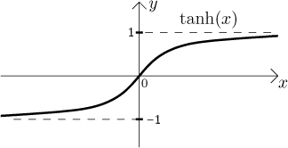
Other Activation Functions…
Noida Institute of Engineering and Technology, Greater Noida
Hyperbolic tangent
𝑔 𝑥 = tan ℎ (𝑥)
= 2 𝜎 2𝑥 − 1
Image from: http://math.feld.cvut.cz/mt/
68

Slide 69
Gradient Based Solution
Noida Institute of Engineering and Technology, Greater Noida
NNs are usually trained using iterative gradient based optimization process.
This drives the solution to result in a error function with a very low value.
Error ( cost ) function in case of binary classification problem is as follows –
– 𝐿 𝑦ො, 𝑦 = −( 𝑦 log 𝑦ො + 1 − 𝑦 log(1 − 𝑦ො)) [ Binary cross entropy ]
By proper training, a neural network may produce reasonable answers for input patterns not seen during training (generalization).
69

Slide 70
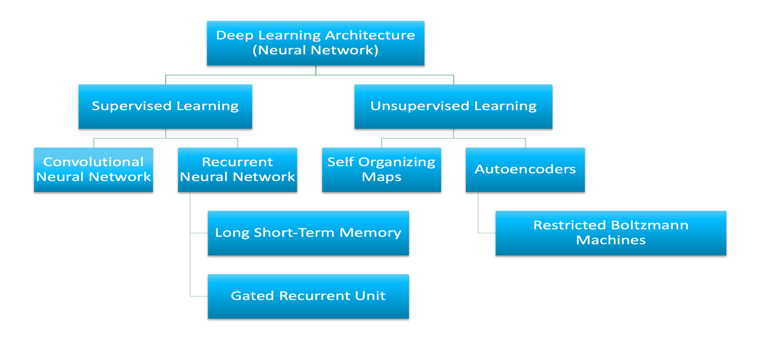
Convolutional Neural Networks
The number of architectures and algorithms that are used in deep learning is wide and varied. This section explores six of the deep learning architectures spanning the past 20 years. Notably, long short-term memory (LSTM) and convolutional neural networks (CNNs) are two of the oldest approaches in this list but also two of the most used in various applications.

Slide 71
Convolutional Neural Networks
This unit classifies deep learning architectures into supervised and unsupervised learning and introduces several popular deep learning architectures: convolutional neural networks, recurrent neural networks (RNNs), long short-term memory/gated recurrent unit (GRU), self-organizing map (SOM), autoencoders (AE) and restricted Boltzman machine (RBM).

Slide 72
Supervised deep learning
Convolutional Neural Networks
Supervised learning refers to the problem space wherein the target to be predicted is clearly labelled within the data that is used for training.
high-level two of the most popular supervised deep learning architectures - convolutional neural networks and recurrent neural networks as well as some of their variants.

Slide 73
Convolutional neural networks
Convolutional Neural Networks
A CNN is a multilayer neural network that was biologically inspired by the animal visual cortex. The architecture is particularly useful in image-processing applications. The first CNN was created by Yann LeCun; at the time, the architecture focused on handwritten character recognition, such as postal code interpretation. As a deep network, early layers recognize features (such as edges), and later layers recombine these features into higher-level attributes of the input.
The LeNet CNN architecture is made up of several layers that implement feature extraction and then classification (see the following image). The image is divided into receptive fields that feed into a convolutional layer, which then extracts features from the input image. The next step is pooling, which reduces the dimensionality of the extracted features (through down-sampling) while retaining the most important information (typically, through max pooling). Another convolution and pooling step is then performed that feeds into a fully connected multilayer perceptron. The final output layer of this network is a set of nodes that identify features of the image (in this case, a node per identified number). You train the network by using back-propagation.

Slide 74
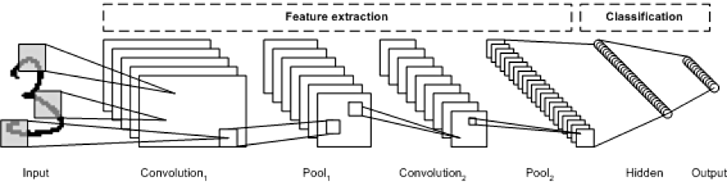
Example applications: Image recognition, video analysis, and natural language processing
Convolutional Neural Networks

Slide 75
Convolutional Neural Networks

Slide 76

Neural Network for Image Data
Convolutional Neural Networks
Suppose the input vector is from an image database.
Task is to classify if the image contains a bird or not.
You have to detect a bird in the image.
Each image is of size say 256X256.
What will be the size of the input layer here ?
66,536
If the first hidden layer contains 1024 units, how many weight parameters will be involved ?
66,536 X 1024 = 68,132,864
76

Slide 77
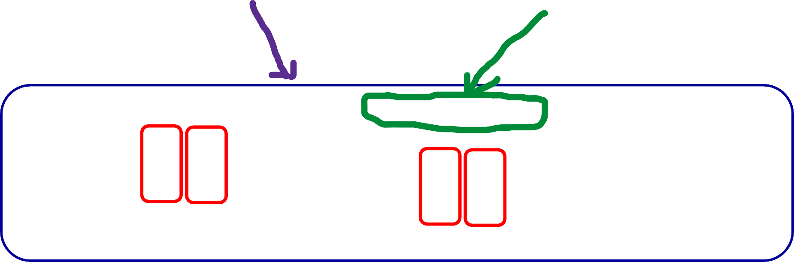
Image Data
Convolutional Neural Networks
High dimensionality
Has redundancies
112 | 112 | 113 | 115 | 124 | 137 | 147 | 151 | 155 | 155 | 155 | 155 | 156 | 155 | 150 | 146 | 136
112 | 114 | 116 | 120 | 130 | 143 | 151 | 152 | 154 | 155 | 156 | 158 | 157 | 154 | 151 | 150 | 146
112 | 116 | 119 | 124 | 134 | 147 | 153 | 152 | 153 | 156 | 163 | 168 | 168 | 162 | 158 | 157 | 154
116 | 119 | 120 | 120 | 130 | 142 | 149 | 150 | 154 | 168 | 175 | 166 | 165 | 171 | 168 | 156 | 164
120 | 125 | 129 | 130 | 135 | 144 | 152 | 155 | 162 | 171 | 178 | 166 | 165 | 173 | 175 | 170 | 171
122 | 129 | 136 | 137 140 146 154 158 167 |  |  |  |  |  | 168 166 162 163 170 177 180 171
Pixel values of a block of an image
Patterns
77

Slide 78

Convolutional Neural Networks: Motivation
Convolutional Neural Networks
Main questions –
Do we need all the edges in this fully connected model?
Can some of the weights be shared?
78

Slide 79
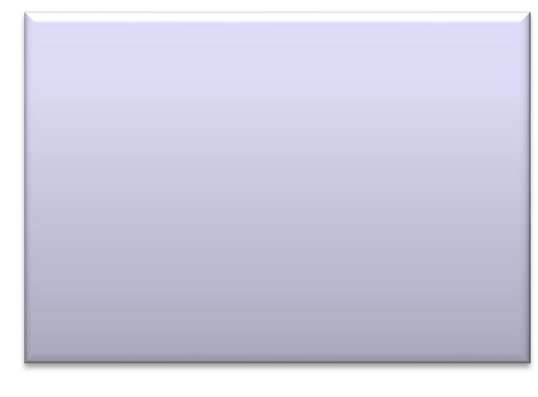

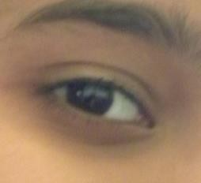
Convolutional Neural Networks
Patterns to learn can be very small compared to the image size.
Example: Eye detector filter in images.
A small pattern detector can be used in place of the entire weight parameter matrix.
“eye” detector
79

Slide 80


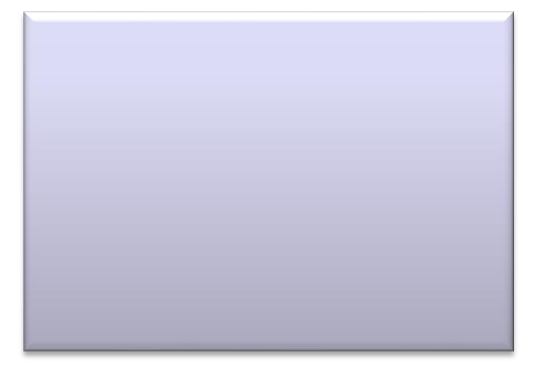
PatternLearning
Convolutional Neural Networks
Same pattern can be at different positions in images.
For examples –eyes.
Same pattern detector can move around and detect eyes at different positions !
80

Slide 81
Convolutional Neural Networks
Convolution Neural Networks (CNNs) use parameter sharing.
Small pattern detectors called filters, are used to convolve over the entire image.
These filters are learned through NN training in the same way as in fully connected networks.
81

Slide 82
Convolutional Neural Networks
Just like a hidden layer in a fully connected NN, convolution layers are used in CNNs.
To handle large size of image data, pooling layers are introduced.
Normalization layers are used in the CNN architectures to accelerate the training process. In this layer, mean and variance of a batch of output are adjusted. Scaling and shifting is performed for the whole batch.
82

Slide 83
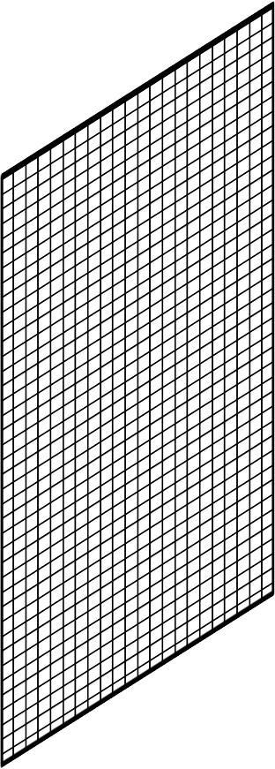

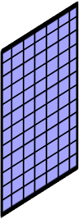
Convolution Operation
Convolutional Neural Networks
Convolution with an image block outputs a real number.
When we slide this filter over the entire image, shifting block by block, we get an array of real numbers.
That is the output of the convolution operation.
Filter
83

Slide 84


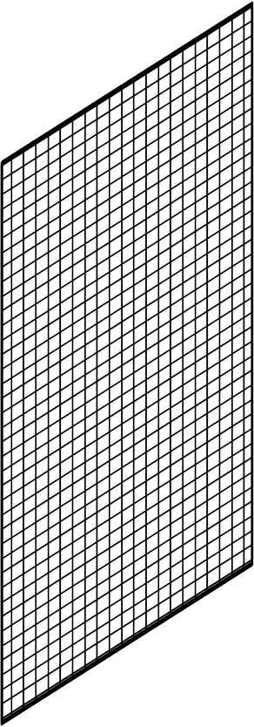
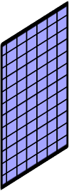

















Convolution Layer
Convolutional Neural Networks
This is how we get the output of a convolution layer.
For each filter, you get an output array like this.
Output of the convolution with one filter
84

Slide 85


Convolutional Neural Networks
3
4
7
8
9
10
12
13
11
14
15
16
1
2
5
9
3 | 4 | 7 | 8
9 | 10 | 12 | 13
11 | 14 | 15 | 16
1 | 2 | 5 | 9
We may think of convolution layer as a hidden layer in which various inputs share a single weight parameter.
85

Slide 86






Convolutional Neural Networks
In case of an image with RGB channels, perform convolution operation on each channel.
Make three copies of the filter and apply convolution operation.
You will get three values, one for each channel.
Let x = (𝑟, 𝑔, 𝑏)
Add all three values of filter mapping to get a single output.
𝑊^{𝑇}𝑥 = 𝑊^{𝑇}𝑟 + 𝑊^{𝑇}𝑔 + 𝑊^{𝑇}𝑏
86

Slide 87
Convolutional Neural Networks
1 | 0 | 0 | 0 | 0 | 1
0 | 1 | 0 | 0 | 1 | 0
0 | 0 | 1 | 1 | 0 | 0
1 | 0 | 0 | 0 | 1 | 0
0 | 1 | 0 | 0 | 1 | 0
0 | 0 | 1 | 0 | 1 | 0
1 | -1 | -1
-1 | 1 | -1
-1 | -1 | 1
Size of the output:
4 × 4 × h
Filter 1
Output will contain h channels, known as feature maps, one for each filter.
-1 | 1 | -1
-1 | 1 | -1
-1 | 1 | -1
Filter 2
6 x 6 image
…
…
-1 | -1 | -1
1 | 1 | 1
-1 | -1 | -1
Filter h
8/25/2021
Source: Ming Li’s Lecture slides, Waterloo University
15
DL&A: Day 3- CNN : Aparajita Ojha

Slide 88







Convolutional Layer and Feature Maps
Convolutional Neural Networks
Input image of size 𝑁 × 𝑁
ℎ filters of size 𝐹 × 𝐹
ℎ 𝐹𝑒𝑎𝑡𝑢𝑟𝑒 𝑚𝑎𝑝𝑠
Each feature map applies its own bias. So, the output becomes
𝑍 = 𝑊^{𝑇}𝑋 + 𝑏, where 𝑋 is the input image.

Slide 89

Activation Maps
Convolutional Neural Networks
Input image of size 𝑁 × 𝑁
ℎ filters of size 𝐹 × 𝐹
ℎ 𝐹𝑒𝑎𝑡𝑢𝑟𝑒 𝑚𝑎𝑝𝑠
An activation function is applied on all the entries of each feature map to get the activation maps. The output becomes
𝒂 = 𝒇(𝒁) = 𝒇(𝑾^{𝑻}𝑿 + 𝒃).

Slide 90


Convolutional Neural Networks
8/25/2021
Figure source_{D}:_{L}F&e_{A:}i _{D}F_{a}e_{y}i L₃₋i’_{C}s _{N}L_{N}ec: t_{A}u_{p}r_{a}e_{ra}s_{j}l_{it}i_{a}de_{O}s_{jh}, _{a}Stanford University
18

Slide 91

CNN architecture
Convolutional Neural Network consists of multiple layers like the input layer, Convolutional layer, Pooling layer, and fully connected layers.
The Convolutional layer applies filters to the input image to extract features, the Pooling layer downsamples the image to reduce computation, and the fully connected layer makes the final prediction. The network learns the optimal filters through backpropagation and gradient descent.

Slide 92

Convolutional Layers
Convolution Neural Networks or covnets are neural networks that share their parameters. Imagine you have an image. It can be represented as a cuboid having its length, width (dimension of the image), and height (i.e the channel as images generally have red, green, and blue channels).
Now imagine taking a small patch of this image and running a small neural network, called a filter or kernel on it, with say, K outputs and representing them vertically. Now slide that neural network across the whole image, as a result, we will get another image with different widths, heights, and depths. Instead of just R, G, and B channels now we have more channels but lesser width and height. This operation is called Convolution. If the patch size is the same as that of the image it will be a regular neural network. Because of this small patch, we have fewer weights.

Slide 93
Convolutional Neural Networks
convolution process
Convolution layers consist of a set of learnable filters (or kernels) having small widths and heights and the same depth as that of input volume (3 if the input layer is image input).
For example, if we have to run convolution on an image with dimensions 34x34x3. The possible size of filters can be axax3, where ‘a’ can be anything like 3, 5, or 7 but smaller as compared to the image dimension.
During the forward pass, we slide each filter across the whole input volume step by step where each step is called stride (which can have a value of 2, 3, or even 4 for high-dimensional images) and compute the dot product between the kernel weights and patch from input volume.
As we slide our filters we’ll get a 2-D output for each filter and we’ll stack them together as a result, we’ll get output volume having a depth equal to the number of filters. The network will learn all the filters.

Slide 94
Types of layers: datasets Let’s take an example by running a covnets on of image of dimension 32 x 32 x 3.
Input Layers: It’s the layer in which we give input to our model. In CNN, Generally, the input will be an image or a sequence of images. This layer holds the raw input of the image with width 32, height 32, and depth 3.
Convolutional Layers: This is the layer, which is used to extract the feature from the input dataset. It applies a set of learnable filters known as the kernels to the input images. The filters/kernels are smaller matrices usually 2×2, 3×3, or 5×5 shape. it slides over the input image data and computes the dot product between kernel weight and the corresponding input image patch. The output of this layer is referred ad feature maps. Suppose we use a total of 12 filters for this layer we’ll get an output volume of dimension 32 x 32 x 12.
Activation Layer: By adding an activation function to the output of the preceding layer, activation layers add nonlinearity to the network. it will apply an element-wise activation function to the output of the convolution layer. Some common activation functions are RELU: max(0, x), Tanh, Leaky RELU, etc. The volume remains unchanged hence output volume will have dimensions 32 x 32 x 12.
Pooling layer: This layer is periodically inserted in the covnets and its main function is to reduce the size of volume which makes the computation fast reduces memory and also prevents overfitting. Two common types of pooling layers are max pooling and average pooling. If we use a max pool with 2 x 2 filters and stride 2, the resultant volume will be of dimension 16x16x12.

Slide 95

Convolutional Neural Networks
max pooling

Slide 96
Flattening: The resulting feature maps are flattened into a one-dimensional vector after the convolution and pooling layers so they can be passed into a completely linked layer for categorization or regression.
Fully Connected Layers: It takes the input from the previous layer and computes the final classification or regression task.
Output Layer: The output from the fully connected layers is then fed into a logistic function for classification tasks like sigmoid or softmax which converts the output of each class into the probability score of each class.
Advantages of Convolutional Neural Networks (CNNs):
Good at detecting patterns and features in images, videos, and audio signals.
Robust to translation, rotation, and scaling invariance.
End-to-end training, no need for manual feature extraction.
Can handle large amounts of data and achieve high accuracy.
Disadvantages of Convolutional Neural Networks (CNNs):
Computationally expensive to train and require a lot of memory.
Can be prone to overfitting if not enough data or proper regularization is used.
Requires large amounts of labeled data.
Interpretability is limited, it’s hard to understand what the network has learned.

Slide 97



Example:
Let’s consider an image and apply the convolution layer, activation layer, and pooling layer operation to extract the inside feature.
Input image: Output:

Slide 98






Activation Maps: Plant Disease Detection Problem
Convolutional Neural Networks
2nd Convolutional Layer Activation Maps
4th Convolutional Layer Activation Maps
Input image
7th Convolutional Layer Activation Maps
10th Convolutional Layer Activation Maps
25-08-2021
13th Convolutional Layer Activation Maps
19

Slide 99

Activation Maps: Plant Disease Detection Problem
Convolutional Neural Networks
Input WCE image
25-08-2021
20

Slide 100
Convolutional Neural Networks
A convolutional neural network is an extension of artificial neural networks (ANN) and is predominantly used for image recognition-based tasks. A previous article covered different types of architectures that are built on artificial neural networks . This article explains the different steps that go into creating a convolutional neural network. These steps are:
Image channels
Convolution
Pooling
Flattening
Full connection

Slide 101
Convolutional Neural Networks
Convolution
Now that the image has been represented as a combination of numbers. the next step in the process is to identify the key features within the image. This is extracted using a method known as convolution.
Convolution is an operation where one function modifies (or convolves) the shape of another. Convolutions in images are generally applied for various reasons such as to sharpen, smooth, and intensify. In CNN, convolutions are applied to extract the prominent features within the images.
For simplicity, the following animation shows how an edge detector filter is applied to just the blue channel output from the previous step. Later, you'll learn how filters are applied to all three channels.

Slide 102

Convolutional Neural Networks

Slide 103
Convolutional Neural Networks
Strided convolutions
During the process of convolution, you can see how the input array is transformed into a smaller array while still maintaining the spatial correlation between the pixels by applying filters. Here, I discuss an option on how to help compress the size of the input array much more.
striding
In the previous section, you saw how the filter is applied to each 3x3 section of the input image. You can see that this window is slid by one column to the right each time, and the end of each row is slid down by one row. In this case, sliding of the filter over the input was done one step at a time. This is referred to as striding. The following example shows the same convolution, but strided with 2 steps.

Slide 104

Convolutional Neural Networks
Strided convolutions

Slide 105
Convolutional Neural Networks
Flattening
You can think of CNN as a sequence of steps that are performed to effectively capture the important aspects of an image before applying ANN on it. In the previous steps, you saw the different transitions that are applied to the original image.

Slide 106

Convolutional Neural Networks Flattening

Slide 107

Convolutional Neural Networks
Fully Connected Layer vs. Convolutional Layer
A fully connected layer refers to a neural network in which each input node is connected to each output node. In a convolutional layer, not all nodes are connected. Here’s what you need to know.
A fully connected layer refers to a neural network in which each neuron applies a linear transformation to the input vector through a weights matrix. As a result, all possible connections layer-to-layer are present, meaning every input of the input vector influences every output of the output vector.
Neural networks are a set of dependent non-linear functions. Each individual function consists of a neuron (or a perceptron). In fully connected layers, the neuron applies a linear transformation to the input vector through a weights matrix. A non-linear transformation is then applied to the product through a non-linear activation function f.

Slide 108

Convolutional Neural Networks
Here, we are taking the dot product between the weights matrix W and the input vector x. The bias term (W0) can be added inside the non-linear function.
The activation function “f” wraps the dot product between the input of the layer and the weights matrix of that layer.

Slide 109


Convolutional Neural Networks
Convolutional Layer
A convolution is effectively a sliding dot product, where the kernel shifts along the input matrix, and we take the dot product between the two as if they were vectors. Below is the vector form of the convolution shown above.
A convolutional layer applies to a neural network in which not all input nodes in a neuron are connected to the output nodes. This gives convolutional layers more flexibility in learning. The number of weights per layer is also a lot smaller, which helps with high-dimensional inputs, such as image data.

Slide 110

CONVOLUTIONAL LAYER
Convolutional Neural Networks
A convolutional layer applies to a neural network in which not all input nodes in a neuron are connected to the output nodes. This gives convolutional layers more flexibility in learning. The number of weights per layer is also a lot smaller, which helps with high-dimensional inputs, such as image data.
Convolutions are not densely connected; not all input nodes affect all output nodes. This gives convolutional layers more flexibility in learning. Moreover, the number of weights per layer is a lot smaller, which helps with high-dimensional inputs such as image data. These advantages are what give CNNs their well-known characteristic of learning features in the data, such as shapes and textures in image data.
In FC layers, the output size of the layer can be specified very simply by choosing the number of columns in the weights matrix. The same cannot be said for convolutional layers. Convolutions have a lot of parameters that can be changed to adapt the output size of the operation.

Slide 111

CALCULATE THE OUTPUT SIZE OF A CONVOLUTIONAL LAYER
The output size is equal to the input size plus two times the padding minus the kernel size over the stride plus one. Most of the time we are dealing with square matrices, so this number will be the same for rows and columns.
If the fraction does not result in an integer, we round up. It’s important to understand the equation. Dividing by the stride makes sense for the reason that when we skip over operations, we are dividing the output size by that number. Two times the padding comes from the fact that the padding is added on both sides of the matrix, and therefore is added twice.

Slide 112
Recurrent neural networks
The RNN is one of the foundational network architectures from which other deep learning architectures are built. The primary difference between a typical multilayer network and a recurrent network is that rather than completely feed-forward connections, a recurrent network might have connections that feed back into prior layers (or into the same layer). This feedback allows RNNs to maintain memory of past inputs and model problems in time.
RNNs consist of a rich set of architectures (we'll look at one popular topology called LSTM next). The key differentiator is feedback within the network, which could manifest itself from a hidden layer, the output layer, or some combination thereof.

Slide 113

Example applications: Speech recognition and handwriting recognition
Recurrent neural networks

Slide 114
LSTM networks
The LSTM was created in 1997 by Hochreiter and Schimdhuber, but it has grown in popularity in recent years as an RNN architecture for various applications. You'll find LSTMs in products that you use every day, such as smartphones. IBM applied LSTMs in IBM Watson® for milestone-setting conversational speech recognition.
The LSTM departed from typical neuron-based neural network architectures and instead introduced the concept of a memory cell. The memory cell can retain its value for a short or long time as a function of its inputs, which allows the cell to remember what's important and not just its last computed value.

Slide 115
LSTM networks
The LSTM memory cell contains three gates that control how information flows into or out of the cell. The input gate controls when new information can flow into the memory. The forget gate controls when an existing piece of information is forgotten, allowing the cell to remember new data. Finally, the output gate controls when the information that is contained in the cell is used in the output from the cell. The cell also contains weights, which control each gate. The training algorithm, commonly BPTT, optimizes these weights based on the resulting network output error.

Slide 116

LSTM networks

Slide 117
Example applications: Image and video captioning systems
LSTM networks
Recent applications of CNNs and LSTMs produced image and video captioning systems in which an image or video is captioned in natural language. The CNN implements the image or video processing, and the LSTM is trained to convert the CNN output into natural language.

Slide 118
GRU networks
In 2014, a simplification of the LSTM was introduced called the gated recurrent unit. This model has two gates, getting rid of the output gate present in the LSTM model. These gates are an update gate and a reset gate. The update gate indicates how much of the previous cell contents to maintain. The reset gate defines how to incorporate the new input with the previous cell contents. A GRU can model a standard RNN simply by setting the reset gate to 1 and the update gate to 0.

Slide 119

Example applications: Natural language text compression, handwriting recognition, speech recognition, gesture recognition, image captioning
The GRU is simpler than the LSTM, can be trained more quickly, and can be more efficient in its execution. However, the LSTM can be more expressive and with more data can lead to better results.

Slide 120
Unsupervised deep learning
Unsupervised learning refers to the problem space wherein there is no target label within the data that is used for training.
This section discusses three unsupervised deep learning architectures: self-organized maps, autoencoders, and restricted boltzmann machines. We also discuss how deep belief networks and deep stacking networks are built based on the underlying unsupervised architecture.

Slide 121
Self-organized maps
Self-organized map (SOM) was invented by Dr. Teuvo Kohonen in 1982 and was popularly known as the Kohonen map. SOM is an unsupervised neural network that creates clusters of the input data set by reducing the dimensionality of the input. SOMs vary from the traditional artificial neural network in quite a few ways.
The first significant variation is that weights serve as a characteristic of the node. After the inputs are normalized, a random input is first chosen. Random weights close to zero are initialized to each feature of the input record. These weights now represent the input node. Several combinations of these random weights represent variations of the input node. The euclidean distance between each of these output nodes with the input node is calculated. The node with the least distance is declared as the most accurate representation of the input and is marked as the best matching unit or BMU. With these BMUs as center points, other units are similarly calculated and assigned to the cluster that it is the distance from. Radius of points around BMU weights are updated based on proximity. Radius is shrunk.

Slide 122

Example applications: Dimensionality reduction, clustering high-dimensional inputs to 2-dimensional output, radiant grade result, and cluster visualization

Slide 123
Autoencoders
Though the history of when autoencoders were invented is hazy, the first known usage of autoencoders was found to be by LeCun in 1987. This variant of an ANN is composed of 3 layers: input, hidden, and output layers.
First, the input layer is encoded into the hidden layer using an appropriate encoding function. The number of nodes in the hidden layer is much less than the number of nodes in the input layer. This hidden layer contains the compressed representation of the original input. The output layer aims to reconstruct the input layer by using a decoder function.

Slide 124

Example applications: Dimensionality reduction, data interpolation, and data compression/decompression

Slide 125
Autoencoders
During the training phase, the difference between the input and the output layer is calculated using an error function, and the weights are adjusted to minimize the error. Unlike traditional unsupervised learning techniques, where there is no data to compare the outputs against, autoencoders learn continuosly using backward propagation. For this reason, autoencoders are classified as self supervised algorithms.

Slide 126
Restricted Boltzmann Machines
Though RBMs became popular much later, they were originally invented by Paul Smolensky in 1986 and was known as a Harmonium.
An RBM is a 2-layered neural network. The layers are input and hidden layers. As shown in the following figure, in RBMs every node in a hidden layer is connected to every node in a visible layer. In a traditional Boltzmann Machine, nodes within the input and hidden layer are also connected. Due to computational complexity, nodes within a layer are not connected in a Restricted Boltzmann Machine.

Slide 127

Restricted Boltzmann Machines

Slide 128
Restricted Boltzmann Machines
During the training phase, RBMs calculate the probabilty distribution of the training set using a stochastic approach. When the training begins, each neuron gets activated at random. Also, the model contains respective hidden and visible bias. While the hidden bias is used in the forward pass to build the activation, the visible bias helps in reconstructing the input.
Because in an RBM the reconstructed input is always different from the original input, they are also known as generative models.
Also, because of the built-in randomness, the same predictions result in different outputs. In fact, this is the most significant difference from an autoencoder, which is a deterministic model.
Example applications: Dimensionality reduction and collaborative filtering

Slide 129

Image classification vs detection vs segmentation
Image Classification​
Image classification involves assigning a label or category to an image or video. The goal is to accurately classify an image into a specific pre-defined category or label. This is done by training a machine learning model with a dataset of images that have been labeled with their respective categories. Once the model has been trained, it can be used to predict the category or label of new, unseen images.

Slide 130
There are two common types of classification:
Single label classification
Multi-label classification
Single label classificaiton​
With single-label classification, you can categorize data to a single class label. This is appropriate when you want to classify a single class, or when labels are mutually exclusive.
For example, an animal can be a cat, or a dog, but not both.
Multi-label classification​
With multiple-label classification, you can categorize data into two or more class labels. If you are trying to recognize multiple features or attributes within an image, you can assign multiple labels.
For example, if you are trying to recognize the attributes of interior design photography, you may recognize the presence of beds, sofas, tables, chairs, fireplaces, and paintings. Using a multi-label classifier would help you recognize multiple of these features within a single image or video frame.

Slide 131
Popular Uses of Image Classification
​
Image classification has many applications, including identifying objects, people, and even diseases in medical images. Here are some popular uses of image classification:
Digital asset management: Automate content tagging of media using AI models.
Content moderation: Moderate user-generated content to remove harmful content like sexually explicit, illegal, or extreme content.
Product categorization: Categorize an e-commerce product into its category - for example, flush-mount lights, pendant lighting, and sconces are all types of lighting.
In more advanced examples, classification models can be combined with other model types. For example, it is common to combine an object detection model with an image classification model. In this case, once a particular object is detected, you can classify that object into relevant subclasses.

Slide 132

Object Detection​
Object detection distinguishes between instances of objects in an image or video, using bounding boxes to indicate their location within the pixel space. Object detection is useful when identifying particular objects in a scene, such as cars parked on the street, or people within a checkout line.

Slide 133
Popular Uses of Object Detection
Detection models will often classify objects into higher-level groupings, and then classify each individual detection into sub-classes. For example, you may detect a vehicle, and then use a classifier to detect the make and model of each vehicle.
Popular Uses of Object Detection​
Object detection is often used to scan digital images or videos to identify every object instance, separate them, and examine their characteristics. Here are some applications for object detection:
People and vehicle detection and tracking: Recognize people and moving vehicles, and use tracking technology to assign unique instances to each detected object across multiple frames in a video.
Demographics: Detect faces, and then classify each face based on gender, ethnicity, and age appearance.
Satellite imagery analysis: Analyze satellite imagery to detect objects on the ground and detect changes across time, for example, airplanes at an airport, land development in geographical areas, or economic activity in urban areas.

Slide 134

Image Segmentation
Segmentation is another type of labeling where each pixel in an image is labeled with given concepts, providing pixel-by-pixel details for a given object. Image segmentation is considered more precise than other object detection methods because it labels individual pixels within an image.
There are two common types of segmentation:
Instance Segmentation
Semantic Segmentation

Slide 135
Semantic Segmentation
Semantic Segmentation​
With semantic segmentation, all pixels of the same type of object or concept are grouped together. For example, in the above left photo, every pixel associated to a car is blue. For autonomous vehicles, you care less about detecting the individual instances of each car, but want to know where any car is.
Instance Segmentation​
Instance segmentation associates collections of pixels to each individual instance of an object. For example, in the above right photo, pixel groups can be seen for individual vehicles, people, trees, building facades, and even clouds. Use instance segmentation if you need to differentiate between unique instances of the same object category in an image.
Popular Uses of Image Segmentation​
Robotic vision: Robotic vision refers to a broad discipline of developing systems and algorithms that enable robots to perceive and understand the world visually. This includes applications in autonomous vehicles, industrial automation, medical robotics, and so on.
Autonomous driving: Likely the most popular use case for segmentation. Autonomous vehicles use segmentation to identify instances of objects like other vehicles, people, and lane markings.
Industrial visual inspection: Identifying defects on equipment or products on a manufacturing line is sometimes best done using segmentation. For example, this can be helpful for surface defect detection, like paint chips, rust, or rivet rash.
Medical imaging: Segmentation can help medical professionals make more accurate diagnoses, including tumor detection, organ segmentation, blood vessel segmentation, and identifying neurological disorders via brain imaging.

Slide 136
Image Segmentation Usage
Cancer has long been a deadly illness. Even in today’s age of technological advancements, cancer can be fatal if we don’t identify it at an early stage. Detecting cancerous cell(s) as quickly as possible can potentially save millions of lives.
The shape of the cancerous cells plays a vital role in determining the severity of the cancer. You might have put the pieces together – object detection will not be very useful here. We will only generate bounding boxes which will not help us in identifying the shape of the cells.
Image Segmentation techniques make a MASSIVE impact here. They help us approach this problem in a more granular manner and get more meaningful results. A win-win for everyone in the healthcare industry.
There are many other applications where Image segmentation is transforming industries:
Traffic Control Systems
Self Driving Cars
Locating objects in satellite images
There are even more applications where Image Segmentation is very useful. Feel free to share them with me in the comments section below this article – let’s see if we can build something together.

Slide 137
Content-Based Image Retrieval (CBIR)
Content-Based Image Retrieval (CBIR) is a way of retrieving images from a database. In CBIR, a user specifies a query image and gets the images in the database similar to the query image. To find the most similar images, CBIR compares the content of the input image to the database images.
More specifically, CBIR compares visual features such as shapes, colors, texture and spatial information and measures the similarity between the query image with the images in the database with respect to those features:

Slide 138
Feature Extraction Methods in CBIR
CBIR systems need to perform feature extraction, which plays a significant role in representing an image’s semantic content.
There are two main categories of visual features: global and local.
Global Features
Global features are those that describe an entire image. They contain information on the entire image. For example, several descriptors characterize color spaces, such as color moments, color histograms, and so on.
Other global features are concerned with other visual elements such as e.g. shapes and texture.
In this diagram, we find various methods for global feature extraction:

Slide 139

Feature Extraction
Local Features
While global features have many advantages, they change under scaling and rotation. For this reason, local features are more reliable in various conditions. Local features describe visual patterns or structures identifiable in small groups of pixels. For example, edges, points, and various image patches.
The descriptors used to extract local features consider the regions centered around the detected visual structures. Those descriptors transform a local pixel neighborhood into a vector presentation.
One of the most used local descriptors is SIFT which stands for Scale-Invariant Feature Transform. It consists of a descriptor and a detector for key points.

Slide 140
Metadata of an image
Photo metadata is the information and specific details concerning a particular image file. This information often includes date created, author, file name, content, themes and more. Photo metadata offers users a better way to organize, sort and maintain image files within a system.
3 types of metadata
There are three main types of metadata: descriptive, administrative, and structural. Descriptive metadata enables discovery, identification, and selection of resources.
For example, author, date created, date modified and file size are examples of very basic document file metadata. Having the ability to search for a particular element (or elements) of that metadata makes it much easier for someone to locate a specific document.

Slide 141
Metadata of an image
Photo metadata is the information and specific details concerning a particular image file. This information often includes date created, author, file name, content, themes and more. Photo metadata offers users a better way to organize, sort and maintain image files within a system.
3 types of metadata
There are three main types of metadata: descriptive, administrative, and structural. Descriptive metadata enables discovery, identification, and selection of resources.
For example, author, date created, date modified and file size are examples of very basic document file metadata. Having the ability to search for a particular element (or elements) of that metadata makes it much easier for someone to locate a specific document.

Slide 142
Function of Metadata
Meta data is to track the lineage of a digital object, to detail its physical characteristics, and. to document its behavior in order to emulate it in future technologies.
Metadata is often stored within the digital file itself, or in an accompanying file. For larger volumes of data, a metadata storage system, such as a database, is required.
Descriptive metadata properties include title, subject, genre, author, and creation date, for example. Rights metadata might include copyright status, rights holder, or license terms. Technical metadata properties include file types, size, creation date and time, and type of compression
Metadata is a set of data that provides information about other data. Metadata contextualizes other data — providing information such as when and how it was gathered — which makes the data easier to find, understand, use, and manage.

Slide 143
Most popular example Categorization of IMAGES
Computer Vision Tasks classification, Instance segmentation. Convolutional Neural Networks, Evolution of CNN Architectures for Image, Recent CNN

Slide 144
Faculty Video Links, Youtube & NPTEL Video Links and Online Courses Details
Youtube/other Video Links
https://nptel.ac.in/courses/106106093/
https://www.youtube.com/watch?v=m-aKj5ovDfg
https://www.youtube.com/watch?v=G4NYQox4n2g

Slide 145
DAILY QUIZ
What is computer vision?
Name three common applications of computer vision.
What is the purpose of image segmentation in computer vision?
What is the difference between object detection and object recognition?
Explain the concept of convolution in convolutional neural networks (CNNs).

Slide 146
DAILY QUIZ
What is optical character recognition (OCR) used for in computer vision?
What is the purpose of non-maximum suppression in object detection algorithms?
What are some common challenges faced in computer vision tasks?
What is the difference between supervised and unsupervised learning in computer vision?
Name three popular deep learning architectures used in computer vision.

Slide 147
WEEKLY ASSIGNMENT
Explain the concept of image filtering and provide examples of commonly used filters in computer vision.
Discuss the differences between image classification and object detection in computer vision. Provide examples of each.
Explain the process of feature extraction in computer vision. How are features used in tasks like object recognition or image matching?
Describe the steps involved in building a convolutional neural network (CNN) for image classification. Discuss the purpose of each step.

Slide 148
WEEKLY ASSIGNMENT
Discuss the challenges and potential solutions for handling occlusion in object detection algorithms.
Compare and contrast traditional computer vision techniques with deep learning-based approaches. What are the advantages and limitations of each?
Explain the concept of image segmentation and its applications in computer vision. Discuss different segmentation methods.
Discuss the concept of optical flow in computer vision. How is it used to analyze motion in videos or sequences of images?
Explain the concept of image registration and its applications in computer vision. Provide examples of scenarios where image registration is useful.
Discuss the role of data augmentation techniques in computer vision tasks. How can data augmentation improve the performance of deep learning models?

Slide 149
WEEKLY ASSIGNMENT
Explain the concept of object tracking in computer vision. Discuss different algorithms or techniques used for object tracking.
Describe the process of image recognition using convolutional neural networks (CNNs). What are the key components and steps involved?
Discuss the concept of depth estimation in computer vision. Explain how depth information can be extracted from 2D images.
Explain the concept of image stitching and its applications. How are multiple images combined to create a panoramic image?
Discuss the challenges and approaches for handling scale invariance in object detection algorithms.
Describe the concept of facial recognition in computer vision. Discuss its applications, advantages, and potential privacy concerns.
Explain the concept of semantic segmentation and its applications in computer vision. Provide examples of scenarios where semantic segmentation is useful.
Discuss the concept of object recognition using feature descriptors. Explain popular feature descriptor algorithms such as SIFT or SURF.
Explain the concept of image super-resolution and its applications. How can low-resolution images be enhanced to improve their quality?
Discuss the role of transfer learning in computer vision. How can pre-trained models be utilized for new tasks or datasets?

Slide 150
MCQ s
Question 1: What is computer vision?
A. The study of computers and their components
B. The field of processing and understanding visual data by computers
C. The development of computer software for image editing
D. The study of visual perception in humans
Question 2: Which of the following is an application of computer vision?
A. Speech recognition
B. Natural language processing
C. Object detection
D. Network security
Question 3: Which technique is commonly used for feature extraction in computer vision?
A. Convolutional Neural Networks (CNN)
B. Decision Trees
C. Support Vector Machines (SVM)
D. K-means clustering

Slide 151
MCQ s
Question 4: What is the purpose of image segmentation in computer vision?
A. Classifying images into different categories
B. Detecting and recognizing objects in images
C. Enhancing and manipulating image quality
D. Dividing an image into meaningful regions or segments
Question 5: Which of the following is an example of an object recognition task in computer vision?
A. Determining the sentiment of an image
B. Identifying the boundaries of objects in an image
C. Recognizing specific objects in an image, such as cars or faces
D. Analyzing the texture or color distribution of an image
Question 6: Which technique is commonly used for image classification in computer vision?
A. Principal Component Analysis (PCA)
B. Naive Bayes classifier
C. Latent Semantic Analysis (LSA)
D. Convolutional Neural Networks (CNN)

Slide 152
MCQ s(CONT’d)
What is computer vision? Answer: c. Computer vision is a field of artificial intelligence that focuses on enabling computers to interpret and understand visual information from images or videos.
Name three common applications of computer vision. Answer: a. Autonomous vehicles, b. Object recognition, c. Medical image analysis
What is the purpose of image segmentation in computer vision? Answer: b. Image segmentation aims to partition an image into meaningful regions or segments to facilitate object detection, tracking, or analysis.
What is the difference between object detection and object recognition? Answer: c. Object detection involves both localizing and classifying objects within an image, while object recognition focuses solely on identifying objects without localizing them.
Explain the concept of convolution in convolutional neural networks (CNNs). Answer: a. Convolution involves applying a filter/kernel to an input image or feature map, computing element-wise multiplications, and summing the results to produce a feature map.

Slide 153
MCQ s(CONT’d)
What is optical character recognition (OCR) used for in computer vision? Answer: b. OCR is used to convert printed or handwritten text from images into machine-readable text, enabling automated text analysis or data extraction.
What is the purpose of non-maximum suppression in object detection algorithms? Answer: a. Non-maximum suppression is used to eliminate redundant bounding box detections by keeping only the most confident detection and suppressing overlapping or lower-confidence detections.
What are some common challenges faced in computer vision tasks? Answer: c. Variations in lighting conditions, occlusion, viewpoint changes, and limited labeled data are common challenges in computer vision tasks.
What is the difference between supervised and unsupervised learning in computer vision? Answer: b. Supervised learning requires labeled training data, where input images are associated with corresponding ground-truth labels. Unsupervised learning involves learning patterns or structures from unlabeled data without explicit labels.

Slide 154
Old Question Papers

Slide 155
SUMMARY
Computer vision is a field of study that deals with the extraction of information from images or videos to understand and interpret visual data. It involves the development of algorithms and techniques to enable computers to perceive and understand the visual world in a way similar to humans.
Computer vision encompasses various tasks and applications, including image classification, object detection, image segmentation, facial recognition, scene understanding, and video analysis. These tasks involve processing and analyzing visual data to extract meaningful information and make decisions based on it.
The fundamental concepts in computer vision include image formation, image processing, feature extraction, and pattern recognition. Image formation deals with how images are captured and represented using pixels. Image processing techniques are used to enhance and manipulate images to improve their quality or extract specific information. Feature extraction involves identifying relevant visual characteristics or patterns from images that can be used for tasks like object recognition or tracking.

Slide 156
SUMMARY
Computer vision techniques employ both traditional computer vision algorithms and deep learning approaches. Traditional algorithms rely on handcrafted features and mathematical models to process and analyze visual data. Deep learning methods, particularly convolutional neural networks (CNNs), have gained popularity in recent years due to their ability to learn directly from raw pixel data and achieve state-of-the-art results in various computer vision tasks.
Computer vision finds applications in diverse fields such as autonomous vehicles, surveillance systems, medical imaging, robotics, augmented reality, and industrial automation. It plays a crucial role in enabling machines to understand and interact with the visual world, opening up possibilities for advanced applications and advancements in numerous domains.
As computer vision continues to evolve, researchers and practitioners explore new techniques, algorithms, and applications to tackle more complex challenges and improve the accuracy and efficiency of visual understanding by machines.

Slide 157
REFERENCES
"Computer Vision: Algorithms and Applications" by Richard Szeliski
This comprehensive book covers the fundamental concepts and algorithms in computer vision, including image formation, image features, stereo vision, multiple view geometry, and object recognition. It also includes numerous examples and MATLAB code snippets.
"Deep Learning for Computer Vision with Python" by Adrian Rosebrock
This book focuses on applying deep learning techniques to solve computer vision problems. It covers topics such as convolutional neural networks (CNNs), image classification, object detection, and image segmentation. The book provides practical examples and code implementations using Python and the Keras library.
"Computer Vision: Models, Learning, and Inference" by Simon J.D. Prince
This book provides a comprehensive introduction to computer vision, covering various topics such as image formation, filtering, feature detection and matching, object recognition, and 3D reconstruction. It also includes discussions on statistical and probabilistic models in computer vision.
https://www.oreilly.com/library/view/datawarehousingarchitecture/0130809020/ch07.html
https://www.slideshare.net/2cdude/data-warehousing-3292359

Slide 158
Any Certification/Courses for this subject
Course Name | Offered By | Duration | Rating | Link
Introduction to Computer Vision and Image Processing | IBM | 1-4 weeks | 4.4 | https://www.coursera.org/learn/introduction-computer-vision-watson-opencv#about
Computer Vision Basics | University at Buffalo | 1-4 weeks | 4.2 | https://www.coursera.org/learn/computer-vision-basics#syllabus

Slide 159
OPTIONAL / CASE STUDIES
OPTIONAL / CASE STUDIES
Factors influencing the adoption of new mobility technologies and services:,
1 Drone Systems and Applications ( Healthcare, Agriculture, Security)
2 Autonomous Vehicular System
3 Motion Prediction for Autonomous Vehicles
4 Clinical applications Robotic surgery

Slide 160
Thank You

